Slide 1
MEPS Insurance Component
Presentation Slides
2016

Slide 2
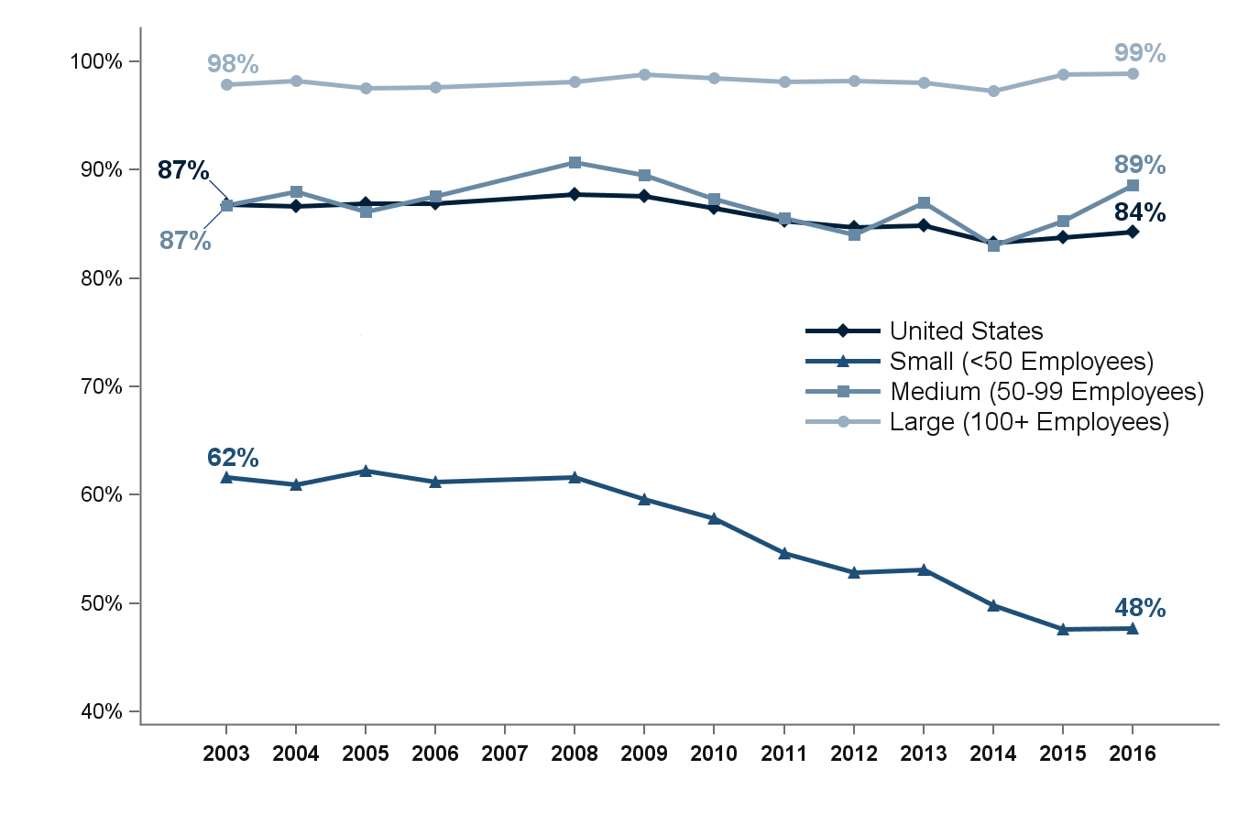


Percentage of private-sector employees in establishments that offer health insurance, by firm size, 2003-2016
Source: Medical Expenditure Panel Survey-Insurance Component, private-sector establishments, 2003-2016.
Note: Medical Expenditure Panel Survey-Insurance Component estimates are not available for 2007.

Slide 3
Percentage of private-sector employees in establishments that offer health insurance, by firm size, 2003-2016
Number of Employees | 2003 | 2004 | 2005 | 2006 | 2008 | 2009 | 2010 | 2011 | 2012 | 2013 | 2014 | 2015 | 2016
U.S. | 86.8% | 86.7% | 86.9% | 86.9% | 87.7% | 87.6% | 86.5% | 85.3% | 84.7% | 84.9% | 83.2% | 83.8% | 84.3%
 | (0.5%) | (0.3%) | (0.5%) | (0.2%) | (0.3%) | (0.2%) | (0.2%) | (0.2%) | (0.3%) | (0.3%) | (0.3%) | (0.2%) | (0.2%)
<50 | 61.6% | 61.0% | 62.2% | 61.2% | 61.6% | 59.6% | 57.8% | 54.7% | 52.9% | 53.1% | 49.8% | 47.6% | 47.7%
 | (0.7%) | (0.5%) | (0.6%) | (0.4%) | (0.5%) | (0.5%) | (0.5%) | (0.4%) | (0.6%) | (0.7%) | (0.6%) | (0.6%) | (0.6%)
50-99 | 86.7% | 88.0% | 86.2% | 87.6% | 90.7% | 89.6% | 87.3% | 85.6% | 84.1% | 87.0% | 83.0% | 85.3% | 88.6%
 | (2.1%) | (1.4%) | (1.7%) | (1.2%) | (0.9%) | (1.3%) | (0.9%) | (1.0%) | (1.4%) | (1.0%) | (1.3%) | (1.2%) | (1.0%)
100+ | 97.9% | 98.2% | 97.5% | 97.7% | 98.2% | 98.8% | 98.5% | 98.1% | 98.2% | 98.0% | 97.3% | 98.8% | 98.9%
 | (0.4%) | (0.3%) | (0.7%) | (0.4%) | (0.3%) | (0.1%) | (0.2%) | (0.2%) | (0.2%) | (0.2%) | (0.2%) | (0.2%) | (0.1%)
Source: Medical Expenditure Panel Survey-Insurance Component, private-sector establishments, 2003-2016.
Note: Medical Expenditure Panel Survey-Insurance Component estimates are not available for 2007.

Slide 4
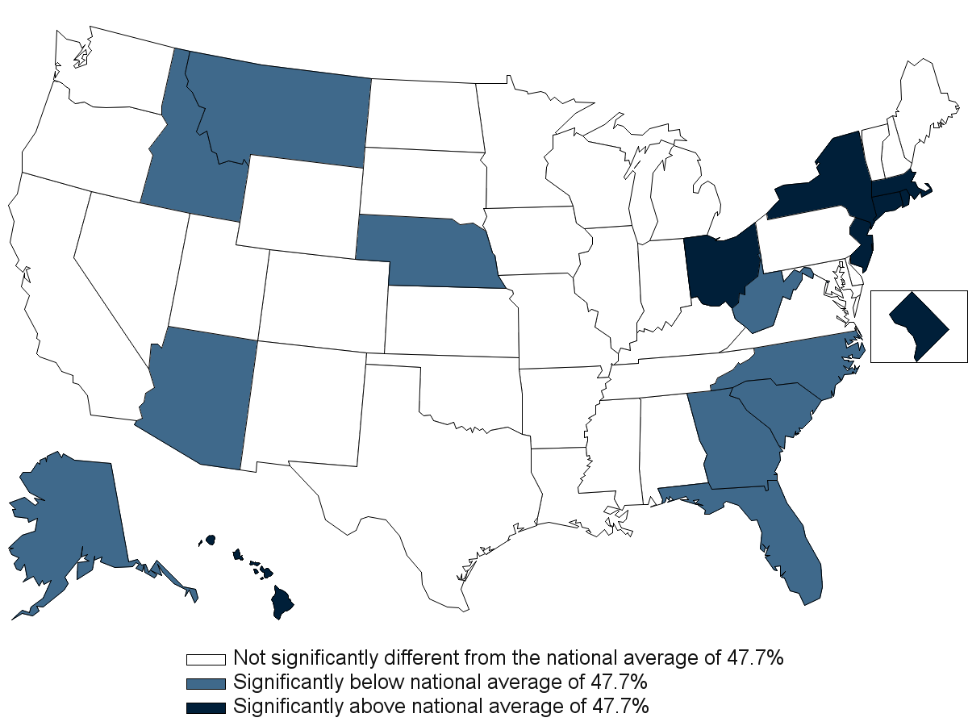
Percentage of private-sector employees in establishments that offer health insurance, by State, firm size <50 employees, 2016
Source: Medical Expenditure Panel Survey-Insurance Component, private-sector establishments, 2016.

Slide 5
Percentage of private-sector employees in establishments that offer health insurance, by State, firm size <50 employees, 2016
Alabama | 48.1% | Kentucky | 47.2% | North Dakota | 53.3%
 | (3.8%) |  | (4.1%) |  | (3.6%)
Alaska | 31.2%* | Louisiana | 49.0% | Ohio | 57.3%*
 | (3.6%) |  | (3.9%) |  | (3.3%)
Arizona | 39.0%* | Maine | 47.2% | Oklahoma | 54.9%
 | (4.0%) |  | (3.7%) |  | (3.6%)
Arkansas | 40.2% | Maryland | 49.0% | Oregon | 42.5%
 | (3.9%) |  | (4.4%) |  | (3.6%)
California | 50.8% | Massachusetts | 58.0%* | Pennsylvania | 53.2%
 | (2.0%) |  | (3.8%) |  | (3.1%)
Colorado | 46.5% | Michigan | 46.2% | Rhode Island | 61.6%*
 | (4.1%) |  | (3.6%) |  | (4.0%)
Connecticut | 56.3%* | Minnesota | 45.7% | South Carolina | 34.4%*
 | (3.9%) |  | (3.8%) |  | (3.3%)
Delaware | 40.6% | Mississippi | 45.4% | South Dakota | 51.3%
 | (4.5%) |  | (4.8%) |  | (3.8%)
District of Columbia | 65.6%* | Missouri | 45.5% | Tennessee | 42.7%
 | (4.1%) |  | (4.3%) |  | (3.8%)
Florida | 39.2%* | Montana | 32.5%* | Texas | 43.2%
 | (3.4%) |  | (3.4%) |  | (2.7%)
Georgia | 38.2%* | Nebraska | 36.2%* | Utah | 42.2%
 | (3.7%) |  | (3.7%) |  | (3.9%)
Hawaii | 89.4%* | Nevada | 55.0% | Vermont | 48.0%
 | (1.8%) |  | (4.2%) |  | (3.4%)
Idaho | 34.7%* | New Hampshire | 51.9% | Virginia | 52.4%
 | (3.6%) |  | (4.4%) |  | (3.9%)
Illinois | 45.7% | New Jersey | 56.9%* | Washington | 44.7%
 | (4.0%) |  | (3.1%) |  | (3.5%)
Indiana | 41.9% | New Mexico | 44.8% | West Virginia | 38.7%*
 | (4.3%) |  | (3.9%) |  | (3.9%)
Iowa | 48.5% | New York | 54.5%* | Wisconsin | 50.9%
 | (3.8%) |  | (3.1%) |  | (3.6%)
Kansas | 45.9% | North Carolina | 39.4%* | Wyoming | 41.6%
 | (4.0%) |  | (3.6%) |  | (3.6%)
Source: Medical Expenditure Panel Survey-Insurance Component, private-sector establishments, 2016.
Note: * Statistically different from the national average of 47.7 percent at p < 0.05. Note that the standard error on the national estimate of 47.7 percent is 0.62 percent.

Slide 6
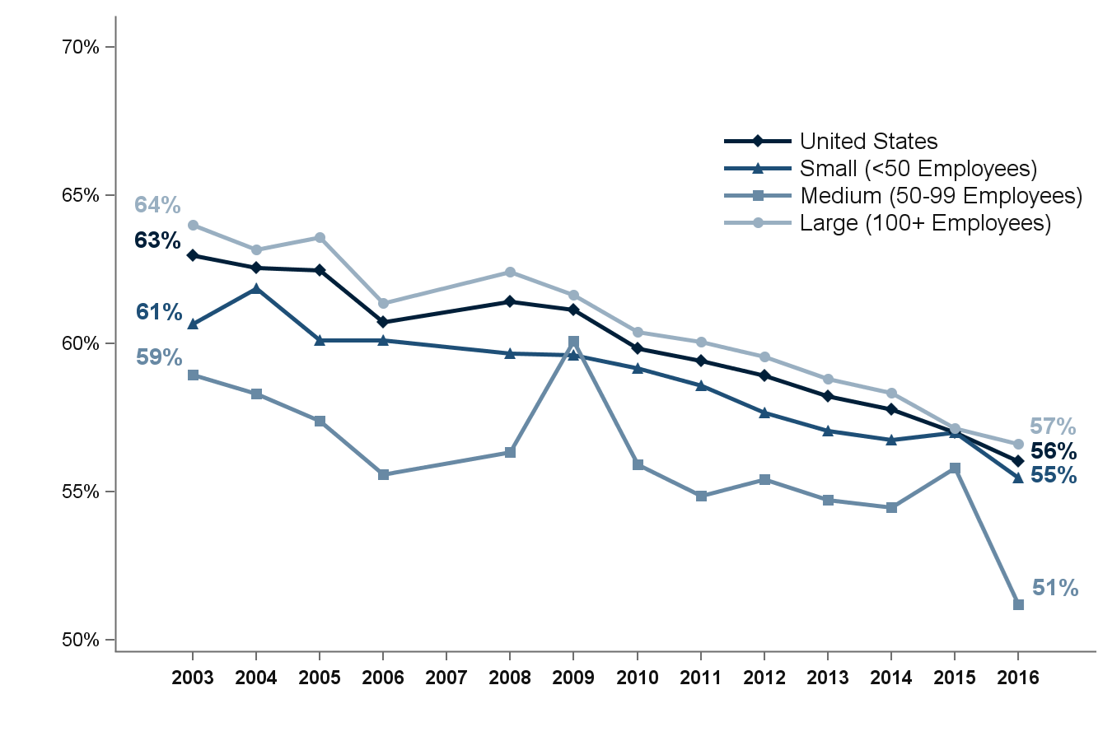
Percentage of private-sector employees who are enrolled in health insurance at establishments that offer health insurance, overall and by firm size, 2003-2016
Source: Medical Expenditure Panel Survey-Insurance Component, private-sector establishments, 2003-2016.
Denominator: Within each category, all employees in establishments that offer health insurance.
Note: Medical Expenditure Panel Survey-Insurance Component estimates are not available for 2007.

Slide 7
Percentage of private-sector employees who are enrolled in health insurance at establishments that offer health insurance, overall and by firm size, 2003-2016
Number of Employees | 2003 | 2004 | 2005 | 2006 | 2008 | 2009 | 2010 | 2011 | 2012 | 2013 | 2014 | 2015 | 2016
U.S. | 63.0% | 62.6% | 62.5% | 60.7% | 61.4% | 61.1% | 59.8% | 59.4% | 58.9% | 58.2% | 57.8% | 57.0% | 56.0%
 | (0.3%) | (0.5%) | (0.4%) | (0.3%) | (0.4%) | (0.4%) | (0.5%) | (0.2%) | (0.4%) | (0.3%) | (0.4%) | (0.4%) | (0.4%)
<50 | 60.7% | 61.9% | 60.1% | 60.1% | 59.7% | 59.6% | 59.2% | 58.6% | 57.7% | 57.1% | 56.8% | 57.0% | 55.5%
 | (0.4%) | (0.5%) | (0.5%) | (0.6%) | (0.2%) | (0.4%) | (0.6%) | (0.5%) | (0.5%) | (0.5%) | (0.6%) | (0.6%) | (0.6%)
50-99 | 58.9% | 58.3% | 57.4% | 55.6% | 56.3% | 60.1% | 55.9% | 54.9% | 55.4% | 54.7% | 54.5% | 55.8% | 51.2%
 | (1.4%) | (1.7%) | (1.5%) | (1.6%) | (1.0%) | (1.0%) | (0.8%) | (1.0%) | (1.2%) | (0.8%) | (1.3%) | (1.2%) | (1.2%)
100+ | 64.0% | 63.2% | 63.6% | 61.4% | 62.4% | 61.6% | 60.4% | 60.0% | 59.5% | 58.8% | 58.3% | 57.1% | 56.6%
 | (0.6%) | (0.7%) | (0.6%) | (0.5%) | (0.5%) | (0.6%) | (0.6%) | (0.3%) | (0.4%) | (0.3%) | (0.5%) | (0.5%) | (0.5%)
Source: Medical Expenditure Panel Survey-Insurance Component, private-sector establishments, 2003-2016.
Denominator: Within each category, all employees in establishments that offer health insurance.
Note: Medical Expenditure Panel Survey-Insurance Component estimates are not available for 2007.

Slide 8
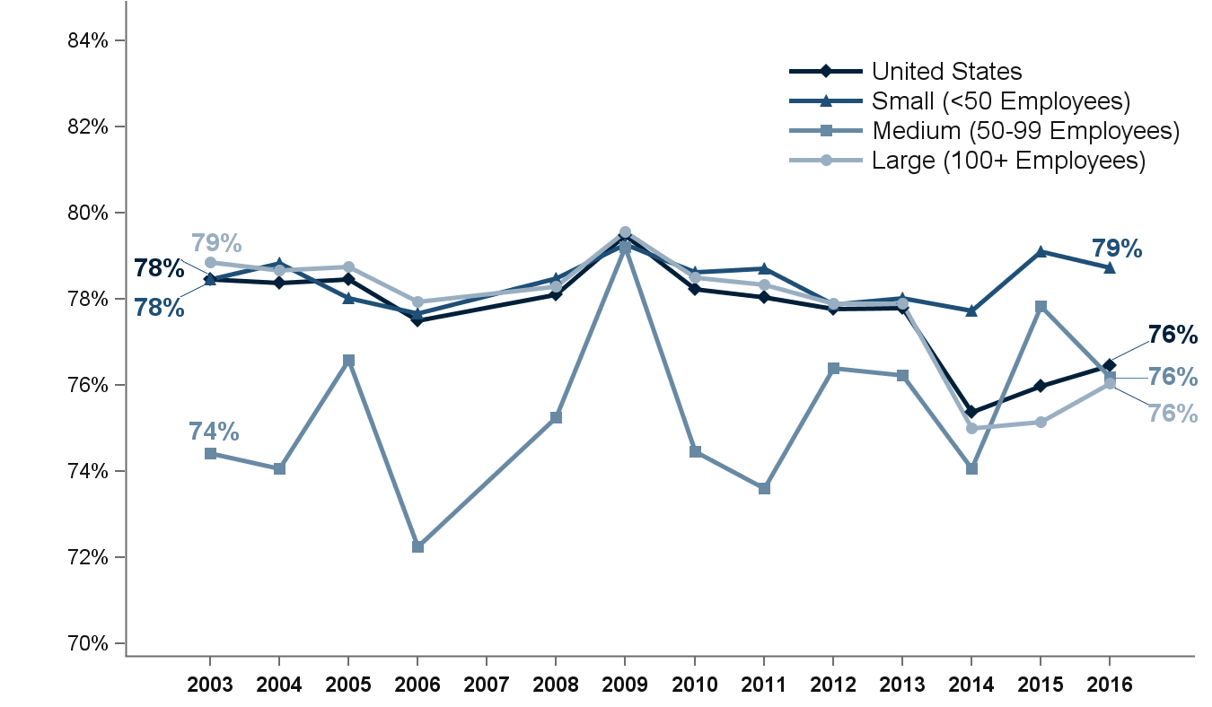
Percentage of private-sector employees eligible for health insurance at establishments that offer health insurance, overall and by firm size, 2003-2016
Source: Medical Expenditure Panel Survey-Insurance Component, private-sector establishments, 2003-2016.
Denominator: Within each category, all employees in establishments that offer health insurance.
Note: Medical Expenditure Panel Survey-Insurance Component estimates are not available for 2007.

Slide 9
Percentage of private-sector employees eligible for health insurance at establishments that offer health insurance, overall and by firm size, 2003-2016
Number of Employees | 2003 | 2004 | 2005 | 2006 | 2008 | 2009 | 2010 | 2011 | 2012 | 2013 | 2014 | 2015 | 2016
U.S. | 78.5% | 78.4% | 78.5% | 77.5% | 78.1% | 79.5% | 78.2% | 78.0% | 77.8% | 77.8% | 75.4% | 76.0% | 76.5%
 | (0.5%) | (0.4%) | (0.5%) | (0.4%) | (0.4%) | (0.3%) | (0.5%) | (0.4%) | (0.3%) | (0.2%) | (0.4%) | (0.4%) | (0.4%)
<50 | 78.5% | 78.8% | 78.0% | 77.7% | 78.5% | 79.3% | 78.6% | 78.7% | 77.9% | 78.0% | 77.7% | 79.1% | 78.7%
 | (0.5%) | (0.6%) | (0.7%) | (0.6%) | (0.4%) | (0.5%) | (0.5%) | (0.6%) | (0.5%) | (0.4%) | (0.6%) | (0.6%) | (0.6%)
50-99 | 74.4% | 74.1% | 76.6% | 72.3% | 75.3% | 79.2% | 74.5% | 73.6% | 76.4% | 76.2% | 74.1% | 77.8% | 76.2%
 | (1.3%) | (1.5%) | (1.4%) | (1.5%) | (1.3%) | (0.8%) | (0.6%) | (1.0%) | (1.2%) | (0.8%) | (1.4%) | (1.2%) | (1.2%)
100+ | 78.8% | 78.7% | 78.8% | 77.9% | 78.3% | 79.6% | 78.5% | 78.3% | 77.9% | 77.9% | 75.0% | 75.2% | 76.0%
 | (0.8%) | (0.6%) | (0.6%) | (0.6%) | (0.4%) | (0.5%) | (0.6%) | (0.4%) | (0.3%) | (0.3%) | (0.5%) | (0.5%) | (0.4%)
Source: Medical Expenditure Panel Survey-Insurance Component, private-sector establishments, 2003-2016.
Denominator: Within each category, all employees in establishments that offer health insurance.
Note: Medical Expenditure Panel Survey-Insurance Component estimates are not available for 2007.

Slide 10
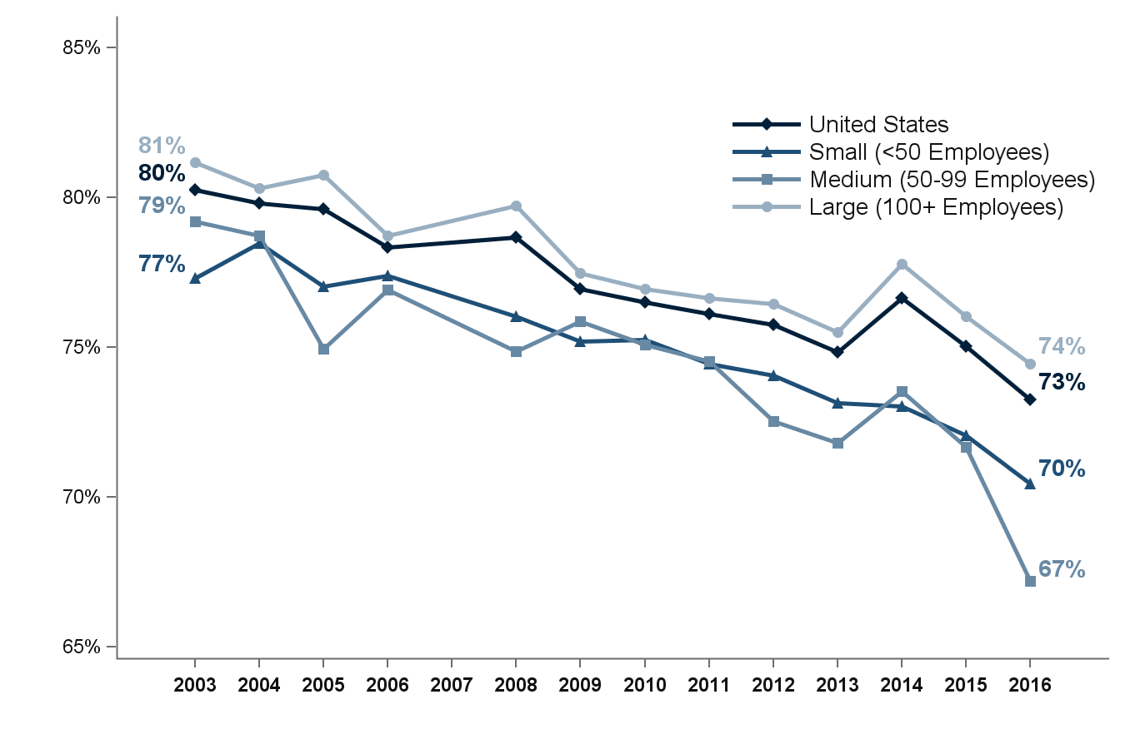
Percentage of eligible private-sector employees who are enrolled in health insurance at establishments that offer health insurance, overall and by firm size, 2003-2016
Source: Medical Expenditure Panel Survey-Insurance Component, private-sector establishments, 2003-2016.
Denominator: Within each category, eligible employees in establishments that offer health insurance.
Note: Medical Expenditure Panel Survey-Insurance Component estimates are not available for 2007.

Slide 11
Percentage of eligible private-sector employees who are enrolled in health insurance at establishments that offer health insurance, overall and by firm size, 2003-2016
Number of Employees | 2003 | 2004 | 2005 | 2006 | 2008 | 2009 | 2010 | 2011 | 2012 | 2013 | 2014 | 2015 | 2016
U.S. | 80.3% | 79.8% | 79.6% | 78.3% | 78.7% | 76.9% | 76.5% | 76.1% | 75.8% | 74.8% | 76.7% | 75.0% | 73.3%
 | (0.3%) | (0.3%) | (0.3%) | (0.3%) | (0.3%) | (0.3%) | (0.2%) | (0.3%) | (0.3%) | (0.2%) | (0.3%) | (0.3%) | (0.3%)
<50 | 77.3% | 78.5% | 77.0% | 77.4% | 76.0% | 75.2% | 75.3% | 74.4% | 74.1% | 73.1% | 73.0% | 72.1% | 70.4%
 | (0.3%) | (0.5%) | (0.6%) | (0.7%) | (0.3%) | (0.3%) | (0.6%) | (0.4%) | (0.4%) | (0.6%) | (0.5%) | (0.5%) | (0.5%)
50-99 | 79.2% | 78.7% | 74.9% | 76.9% | 74.9% | 75.9% | 75.1% | 74.5% | 72.5% | 71.8% | 73.5% | 71.7% | 67.2%
 | (0.7%) | (1.2%) | (1.2%) | (1.3%) | (0.5%) | (0.9%) | (0.7%) | (0.6%) | (0.8%) | (1.0%) | (1.0%) | (1.1%) | (1.2%)
100+ | 81.2% | 80.3% | 80.7% | 78.7% | 79.7% | 77.5% | 76.9% | 76.7% | 76.4% | 75.5% | 77.8% | 76.0% | 74.4%
 | (0.4%) | (0.4%) | (0.5%) | (0.4%) | (0.4%) | (0.5%) | (0.3%) | (0.3%) | (0.4%) | (0.3%) | (0.3%) | (0.3%) | (0.4%)
Source: Medical Expenditure Panel Survey-Insurance Component, private-sector establishments, 2003-2016.
Denominator: Within each category, eligible employees in establishments that offer health insurance.
Note: Medical Expenditure Panel Survey-Insurance Component estimates are not available for 2007.

Slide 12
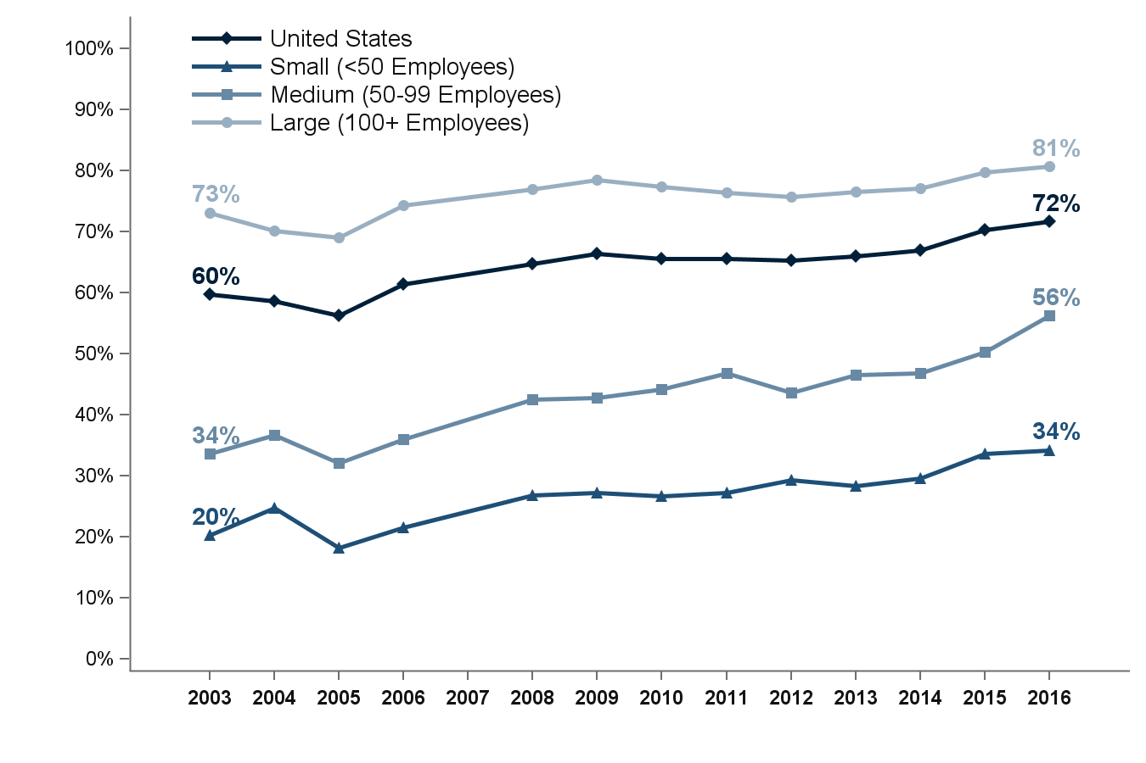
Percentage of private-sector employees working in establishments that offer two or more health insurance plans, overall and by firm size, 2003-2016
Source: Medical Expenditure Panel Survey-Insurance Component, private-sector establishments, 2003-2016.
Denominator: Within each category, all employees in establishments that offer health insurance.
Note: Medical Expenditure Panel Survey-Insurance Component estimates are not available for 2007.

Slide 13
Percentage of private-sector employees working in establishments that offer two or more health insurance plans, overall and by firm size, 2003-2016
Number of Employees | 2003 | 2004 | 2005 | 2006 | 2008 | 2009 | 2010 | 2011 | 2012 | 2013 | 2014 | 2015 | 2016
U.S. | 59.7% | 58.6% | 56.3% | 61.4% | 64.8% | 66.5% | 65.6% | 65.5% | 65.3% | 66.0% | 67.0% | 70.2% | 71.7%
 | (0.7%) | (0.8%) | (0.8%) | (0.7%) | (0.6%) | (0.7%) | (0.8%) | (0.5%) | (0.7%) | (0.6%) | (0.6%) | (0.5%) | (0.5%)
<50 | 20.3% | 24.7% | 18.2% | 21.5% | 26.8% | 27.3% | 26.7% | 27.2% | 29.3% | 28.4% | 29.6% | 33.6% | 34.2%
 | (1.1%) | (0.9%) | (1.1%) | (1.1%) | (0.7%) | (0.9%) | (0.8%) | (0.9%) | (0.8%) | (1.0%) | (0.9%) | (1.1%) | (1.0%)
50-99 | 33.6% | 36.7% | 32.1% | 36.0% | 42.5% | 42.8% | 44.1% | 46.8% | 43.7% | 46.6% | 46.8% | 50.2% | 56.2%
 | (2.6%) | (2.5%) | (2.5%) | (2.4%) | (1.7%) | (2.0%) | (1.9%) | (2.2%) | (1.7%) | (2.2%) | (2.1%) | (2.2%) | (2.0%)
100+ | 73.1% | 70.2% | 69.0% | 74.3% | 76.9% | 78.5% | 77.3% | 76.3% | 75.7% | 76.5% | 77.0% | 79.7% | 80.7%
 | (0.7%) | (0.9%) | (0.9%) | (0.6%) | (0.7%) | (0.7%) | (1.0%) | (0.7%) | (0.7%) | (0.7%) | (0.6%) | (0.6%) | (0.6%)
Source: Medical Expenditure Panel Survey-Insurance Component, private-sector establishments, 2003-2016.
Denominator: Within each category, all employees in establishments that offer health insurance.
Note: Medical Expenditure Panel Survey-Insurance Component estimates are not available for 2007.

Slide 14
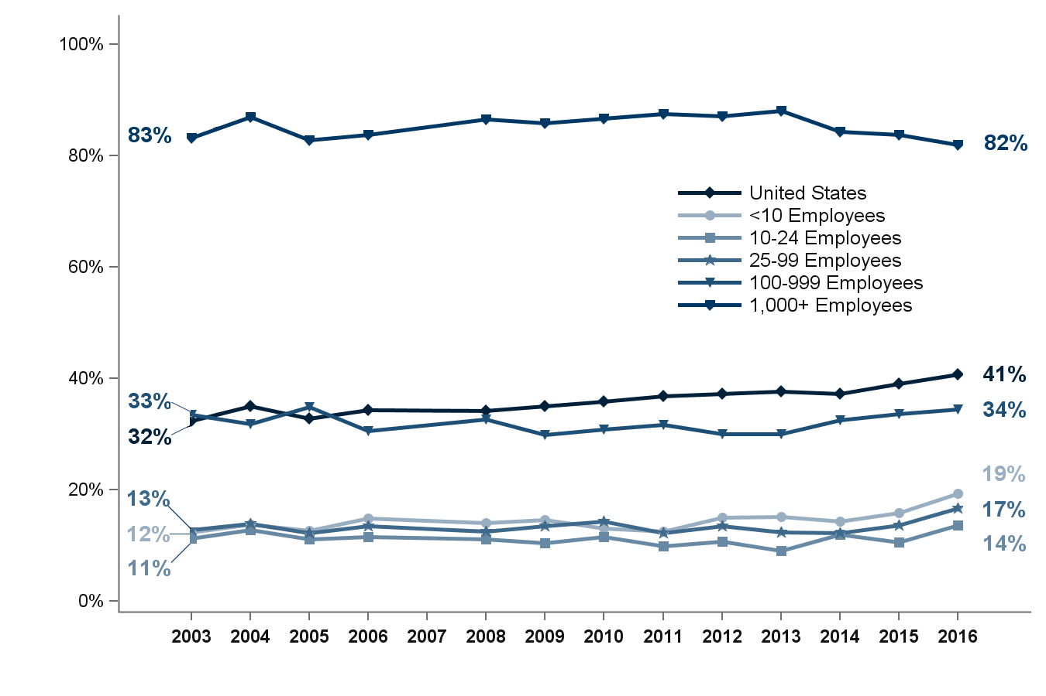
Percentage of private-sector establishments that offer health insurance that self-insure at least one plan, overall and by detailed firm size, 2003-2016
Source: Medical Expenditure Panel Survey-Insurance Component, private-sector establishments, 2003-2016.
Note: Medical Expenditure Panel Survey-Insurance Component estimates are not available for 2007.

Slide 15
Percentage of private-sector establishments that offer health insurance that self-insure at least one plan, overall and by detailed firm size, 2003-2016
Number of Employees | 2003 | 2004 | 2005 | 2006 | 2008 | 2009 | 2010 | 2011 | 2012 | 2013 | 2014 | 2015 | 2016
U.S. | 32.4% | 35.0% | 32.7% | 34.4% | 34.2% | 35.1% | 35.8% | 36.9% | 37.2% | 37.6% | 37.2% | 39.0% | 40.7%
 | (1.0%) | (0.7%) | (0.5%) | (0.5%) | (0.4%) | (0.4%) | (0.5%) | (0.5%) | (0.5%) | (0.5%) | (0.5%) | (0.5%) | (0.6%)
<10 | 12.4% | 13.7% | 12.7% | 14.9% | 14.0% | 14.6% | 13.1% | 12.6% | 14.9% | 15.2% | 14.4% | 15.8% | 19.3%
 | (0.4%) | (0.6%) | (0.8%) | (0.9%) | (0.8%) | (0.7%) | (0.5%) | (0.8%) | (0.9%) | (0.4%) | (0.8%) | (1.0%) | (1.4%)
10-24 | 11.3% | 12.7% | 11.2% | 11.6% | 11.1% | 10.4% | 11.6% | 9.9% | 10.7% | 9.0% | 12.0% | 10.6% | 13.6%
 | (0.8%) | (0.7%) | (0.5%) | (0.6%) | (0.9%) | (0.4%) | (0.8%) | (0.7%) | (0.7%) | (0.7%) | (1.0%) | (1.0%) | (1.1%)
25-99 | 12.7% | 13.9% | 12.2% | 13.5% | 12.6% | 13.4% | 14.3% | 12.2% | 13.5% | 12.4% | 12.2% | 13.7% | 16.6%
 | (0.7%) | (0.9%) | (0.9%) | (0.7%) | (0.8%) | (0.7%) | (0.7%) | (0.7%) | (0.7%) | (0.7%) | (0.8%) | (0.9%) | (0.9%)
100-999 | 33.5% | 31.8% | 34.9% | 30.6% | 32.7% | 29.9% | 30.9% | 31.7% | 30.1% | 30.1% | 32.5% | 33.7% | 34.4%
 | (1.9%) | (1.3%) | (1.4%) | (0.9%) | (1.3%) | (0.7%) | (0.9%) | (1.1%) | (0.8%) | (1.0%) | (1.2%) | (1.2%) | (1.2%)
1,000+ | 83.2% | 87.0% | 82.7% | 83.8% | 86.5% | 85.8% | 86.6% | 87.5% | 87.1% | 88.0% | 84.2% | 83.8% | 81.9%
 | (1.7%) | (0.6%) | (0.5%) | (0.7%) | (0.5%) | (0.4%) | (0.6%) | (0.5%) | (0.7%) | (0.5%) | (0.8%) | (0.8%) | (0.8%)
Source: Medical Expenditure Panel Survey-Insurance Component, private-sector establishments, 2003-2016.
Note: Medical Expenditure Panel Survey-Insurance Component estimates are not available for 2007.

Slide 16
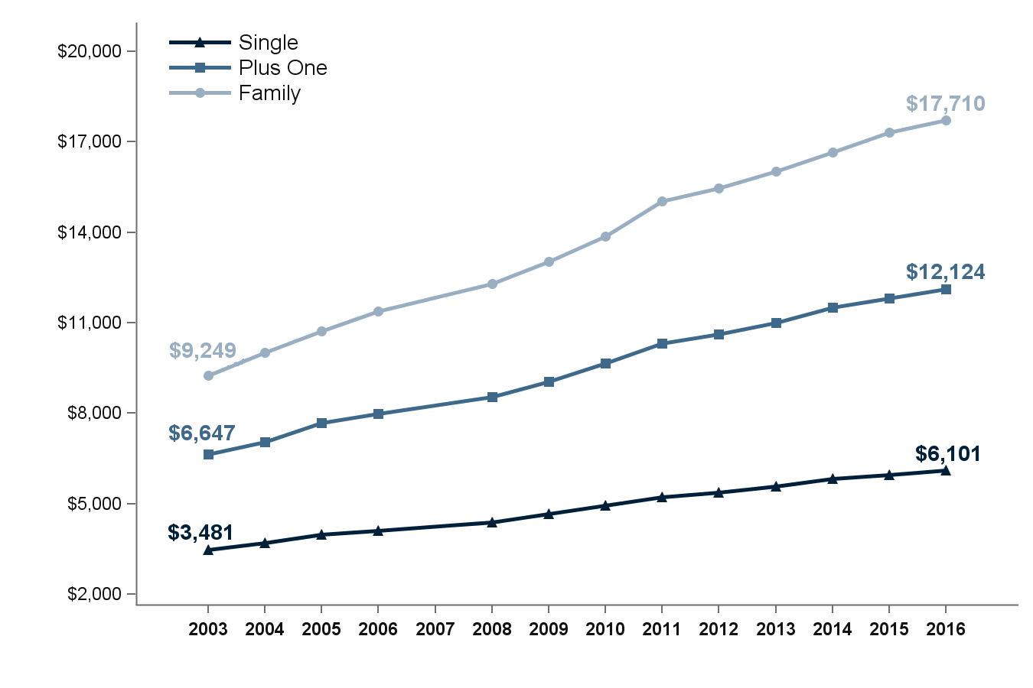
Average total premiums per enrolled employee for single, employee-plus-one, and family coverage, 2003-2016
Source: Medical Expenditure Panel Survey-Insurance Component, private-sector establishments, 2003-2016.
Note: Medical Expenditure Panel Survey-Insurance Component estimates are not available for 2007.

Slide 17
Average total premiums per enrolled employee for single, employee-plus-one, and family coverage, 2003-2016
Coverage | 2003 | 2004 | 2005 | 2006 | 2008 | 2009 | 2010 | 2011 | 2012 | 2013 | 2014 | 2015 | 2016
Single | $3,481 | $3,705 | $3,991 | $4,118 | $4,386 | $4,669 | $4,940 | $5,222 | $5,384 | $5,571 | $5,832 | $5,963 | $6,101
 | ($11) | ($16) | ($24) | ($25) | ($15) | ($21) | ($22) | ($26) | ($28) | ($23) | ($25) | ($26) | ($27)
Plus One | $6,647 | $7,056 | $7,671 | $7,988 | $8,535 | $9,053 | $9,664 | $10,329 | $10,621 | $10,990 | $11,503 | $11,800 | $12,124
 | ($33) | ($39) | ($44) | ($48) | ($43) | ($34) | ($60) | ($105) | ($56) | ($54) | ($60) | ($58) | ($60)
Family | $9,249 | $10,006 | $10,728 | $11,381 | $12,298 | $13,027 | $13,871 | $15,022 | $15,473 | $16,029 | $16,655 | $17,322 | $17,710
 | ($45) | ($28) | ($41) | ($32) | ($81) | ($25) | ($75) | ($98) | ($95) | ($61) | ($79) | ($95) | ($84)
Source: Medical Expenditure Panel Survey-Insurance Component, private-sector establishments, 2003-2016.
Note: Medical Expenditure Panel Survey-Insurance Component estimates are not available for 2007.

Slide 18
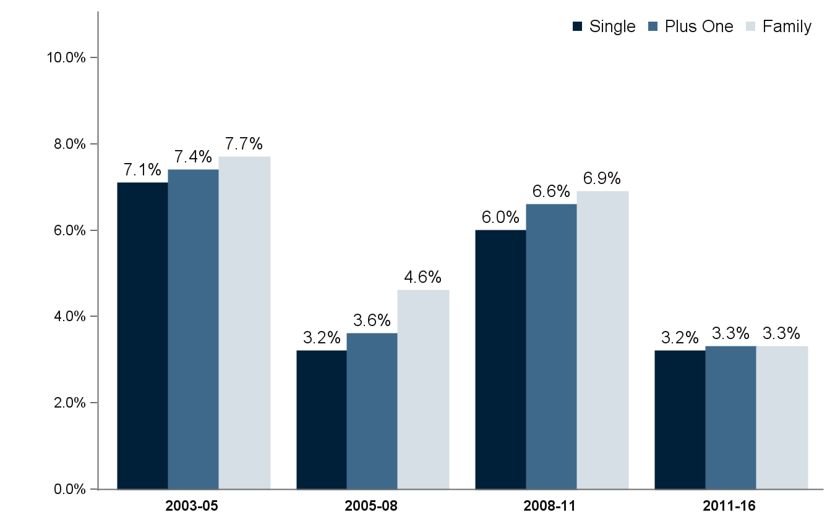
Average annual growth rates in total premiums per enrolled employee for single, employee-plus-one, and family coverage, 2003-2016
Source: Medical Expenditure Panel Survey-Insurance Component, private-sector establishments, 2003-2016.
Note: Medical Expenditure Panel Survey-Insurance Component estimates are not available for 2007.

Slide 19
Average annual growth rates in total premiums per enrolled employee for single, employee-plus-one, and family coverage, 2003-2016
Period | Single | Employee-plus-one | Family
2003-05 | 7.1% | 7.4% | 7.7%
 | (0.4%) | (0.4%) | (0.3%)
2005-08 | 3.2% | 3.6% | 4.6%
 | (0.2%) | (0.3%) | (0.3%)
2008-11 | 6.0% | 6.6% | 6.9%
 | (0.2%) | (0.4%) | (0.3%)
2011-16 | 3.2% | 3.3% | 3.3%
 | (0.1%) | (0.3%) | (0.2%)
Source: Medical Expenditure Panel Survey-Insurance Component, private-sector establishments, 2003-2016.
Note: Medical Expenditure Panel Survey-Insurance Component estimates are not available for 2007.

Slide 20
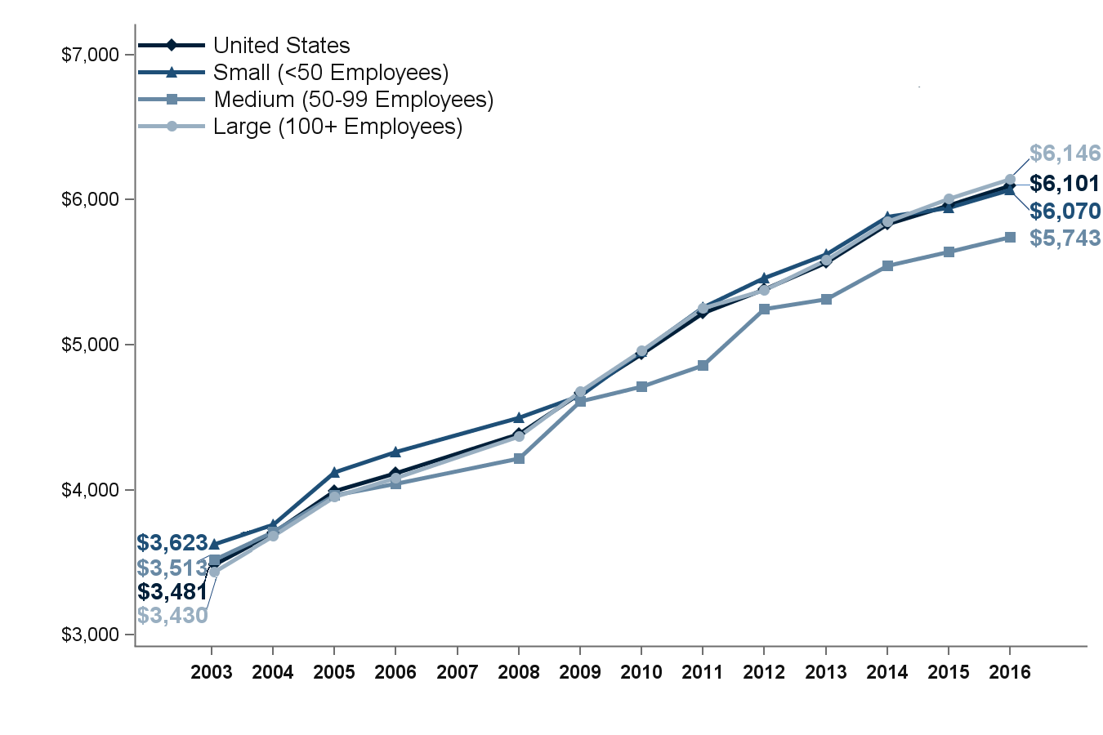
Average total single premium per enrolled employee, by firm size, 2003-2016
Source: Medical Expenditure Panel Survey-Insurance Component, private-sector establishments, 2003-2016.
Note: Medical Expenditure Panel Survey-Insurance Component estimates are not available for 2007.

Slide 21
Average total single premium per enrolled employee, by firm size, 2003-2016
Number of Employees | 2003 | 2004 | 2005 | 2006 | 2008 | 2009 | 2010 | 2011 | 2012 | 2013 | 2014 | 2015 | 2016
U.S. | $3,481 | $3,705 | $3,991 | $4,118 | $4,386 | $4,669 | $4,940 | $5,222 | $5,384 | $5,571 | $5,832 | $5,963 | $6,101
 | ($11) | ($16) | ($24) | ($25) | ($15) | ($21) | ($22) | ($26) | ($28) | ($23) | ($25) | ($26) | ($27)
<50 | $3,623 | $3,763 | $4,121 | $4,260 | $4,501 | $4,652 | $4,956 | $5,258 | $5,460 | $5,628 | $5,886 | $5,947 | $6,070
 | ($26) | ($44) | ($45) | ($34) | ($31) | ($31) | ($34) | ($39) | ($60) | ($39) | ($55) | ($55) | ($53)
50-99 | $3,513 | $3,711 | $3,962 | $4,045 | $4,215 | $4,614 | $4,713 | $4,861 | $5,246 | $5,314 | $5,549 | $5,642 | $5,743
 | ($51) | ($90) | ($70) | ($66) | ($37) | ($82) | ($52) | ($75) | ($39) | ($73) | ($82) | ($104) | ($96)
100+ | $3,430 | $3,684 | $3,950 | $4,080 | $4,370 | $4,681 | $4,959 | $5,252 | $5,378 | $5,584 | $5,851 | $6,006 | $6,146
 | ($16) | ($25) | ($32) | ($32) | ($26) | ($38) | ($23) | ($31) | ($28) | ($29) | ($30) | ($31) | ($32)
Source: Medical Expenditure Panel Survey-Insurance Component, private-sector establishments, 2003-2016.
Note: Medical Expenditure Panel Survey-Insurance Component estimates are not available for 2007.

Slide 22
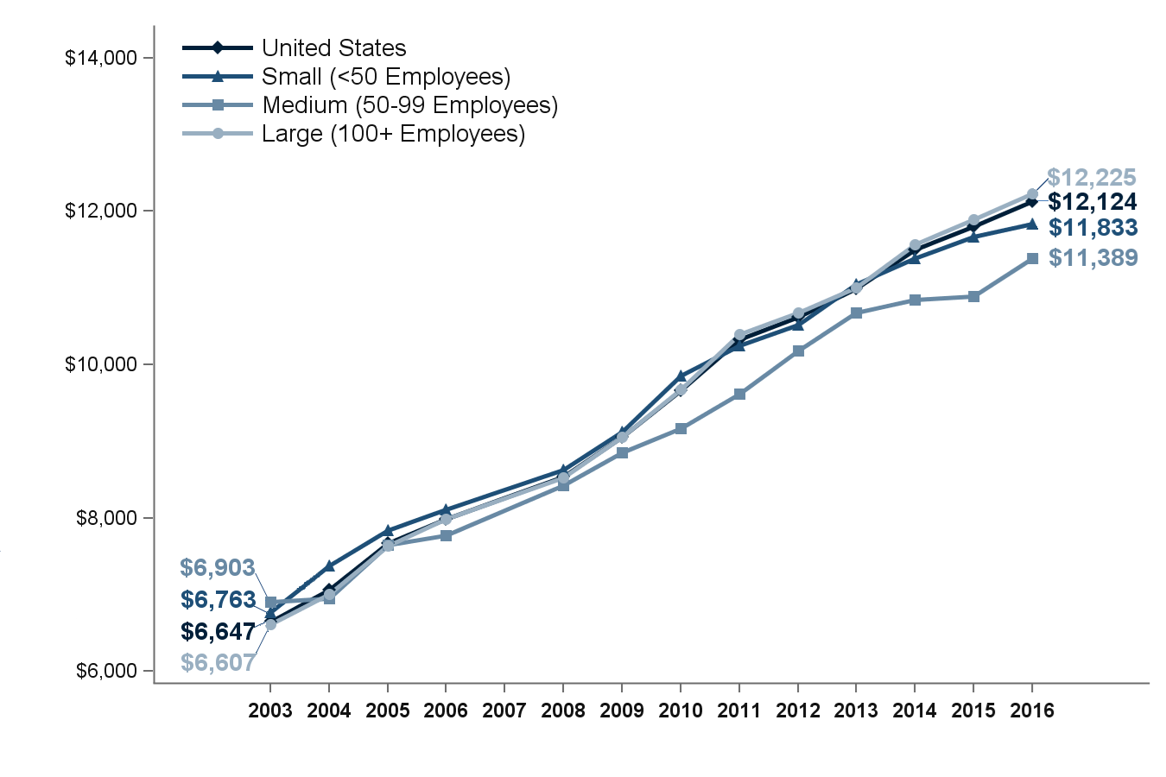
Average total employee-plus-one premium per enrolled employee,
by firm size, 2003-2016
Source: Medical Expenditure Panel Survey-Insurance Component, private-sector establishments, 2003-2016.
Note: Medical Expenditure Panel Survey-Insurance Component estimates are not available for 2007.

Slide 23
Average total employee-plus-one premium per enrolled employee,
by firm size, 2003-2016
Number of Employees | 2003 | 2004 | 2005 | 2006 | 2008 | 2009 | 2010 | 2011 | 2012 | 2013 | 2014 | 2015 | 2016
U.S. | $6,647 | $7,056 | $7,671 | $7,988 | $8,535 | $9,053 | $9,664 | $10,329 | $10,621 | $10,990 | $11,503 | $11,800 | $12,124
 | ($33) | ($39) | ($44) | ($48) | ($43) | ($34) | ($60) | ($105) | ($56) | ($54) | ($60) | ($58) | ($60)
<50 | $6,763 | $7,373 | $7,841 | $8,105 | $8,631 | $9,124 | $9,850 | $10,253 | $10,524 | $11,050 | $11,386 | $11,666 | $11,833
 | ($87) | ($125) | ($115) | ($113) | ($110) | ($119) | ($80) | ($104) | ($121) | ($92) | ($163) | ($158) | ($156)
50-99 | $6,903 | $6,945 | $7,645 | $7,774 | $8,421 | $8,852 | $9,166 | $9,615 | $10,178 | $10,673 | $10,845 | $10,885 | $11,389
 | ($154) | ($165) | ($138) | ($167) | ($88) | ($148) | ($124) | ($192) | ($185) | ($330) | ($187) | ($198) | ($227)
100+ | $6,607 | $7,002 | $7,640 | $7,981 | $8,527 | $9,058 | $9,669 | $10,394 | $10,672 | $11,006 | $11,571 | $11,892 | $12,225
 | ($42) | ($40) | ($60) | ($61) | ($60) | ($34) | ($62) | ($113) | ($70) | ($59) | ($68) | ($66) | ($68)
Source: Medical Expenditure Panel Survey-Insurance Component, private-sector establishments, 2003-2016.
Note: Medical Expenditure Panel Survey-Insurance Component estimates are not available for 2007.

Slide 24
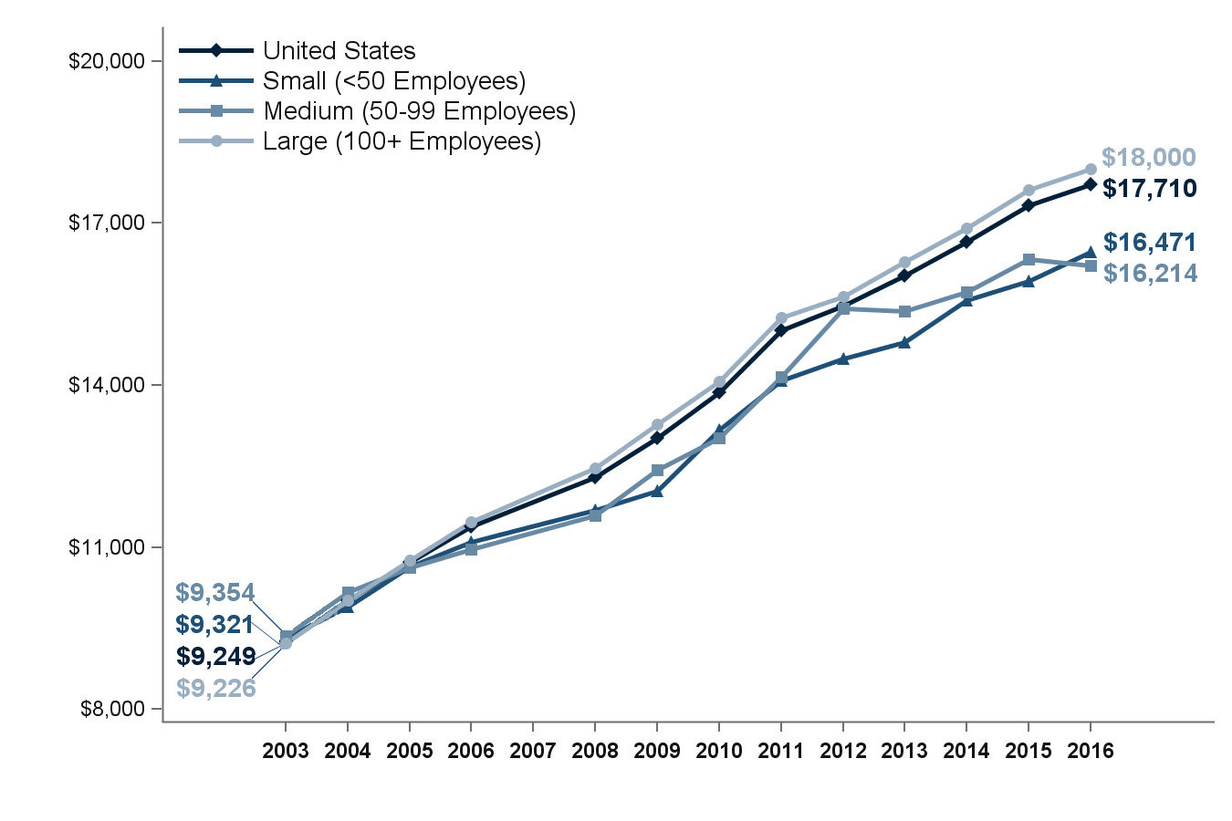
Average total family premium per enrolled employee, by firm size, 2003-2016
Source: Medical Expenditure Panel Survey-Insurance Component, private-sector establishments, 2003-2016.
Note: Medical Expenditure Panel Survey-Insurance Component estimates are not available for 2007.

Slide 25
Average total family premium per enrolled employee, by firm size, 2003-2016
Number of Employees | 2003 | 2004 | 2005 | 2006 | 2008 | 2009 | 2010 | 2011 | 2012 | 2013 | 2014 | 2015 | 2016
U.S. | $9,249 | $10,006 | $10,728 | $11,381 | $12,298 | $13,027 | $13,871 | $15,022 | $15,473 | $16,029 | $16,655 | $17,322 | $17,710
 | ($45) | ($28) | ($41) | ($32) | ($81) | ($25) | ($75) | ($98) | ($95) | ($61) | ($79) | ($95) | ($84)
<50 | $9,321 | $9,898 | $10,632 | $11,095 | $11,679 | $12,041 | $13,170 | $14,086 | $14,496 | $14,787 | $15,575 | $15,919 | $16,471
 | ($123) | ($106) | ($106) | ($116) | ($182) | ($129) | ($111) | ($145) | ($181) | ($89) | ($177) | ($212) | ($207)
50-99 | $9,354 | $10,172 | $10,619 | $10,954 | $11,578 | $12,431 | $13,019 | $14,151 | $15,421 | $15,376 | $15,732 | $16,336 | $16,214
 | ($177) | ($190) | ($208) | ($301) | ($128) | ($229) | ($153) | ($168) | ($273) | ($268) | ($274) | ($335) | ($348)
100+ | $9,226 | $10,019 | $10,754 | $11,471 | $12,468 | $13,271 | $14,074 | $15,245 | $15,641 | $16,284 | $16,903 | $17,612 | $18,000
 | ($57) | ($50) | ($55) | ($51) | ($95) | ($33) | ($85) | ($117) | ($114) | ($82) | ($91) | ($110) | ($95)
Source: Medical Expenditure Panel Survey-Insurance Component, private-sector establishments, 2003-2016.
Note: Medical Expenditure Panel Survey-Insurance Component estimates are not available for 2007.

Slide 26
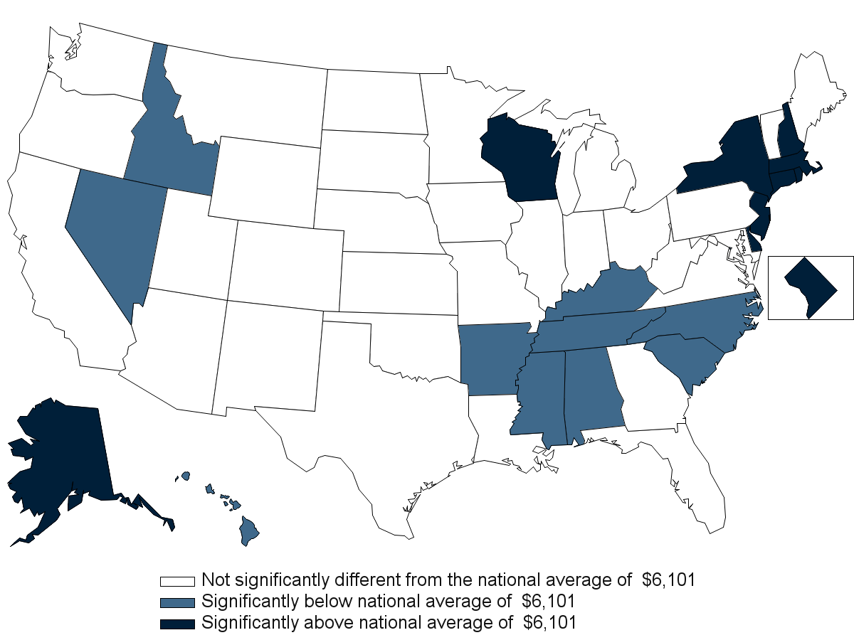
Average total single premium per enrolled employee, by state, 2016
Source: Medical Expenditure Panel Survey-Insurance Component, private-sector establishments, 2016.

Slide 27
Average total single premium per enrolled employee, by state, 2016
Alabama | $5,536* | Kentucky | $5,758* | North Dakota | $6,155
 | ($136) |  | ($158) |  | ($122)
Alaska | $7,886* | Louisiana | $5,735 | Ohio | $6,291
 | ($210) |  | ($186) |  | ($132)
Arizona | $6,046 | Maine | $6,212 | Oklahoma | $5,784
 | ($153) |  | ($133) |  | ($162)
Arkansas | $5,341* | Maryland | $6,158 | Oregon | $5,974
 | ($138) |  | ($218) |  | ($144)
California | $6,054 | Massachusetts | $6,621* | Pennsylvania | $6,201
 | ($82) |  | ($135) |  | ($107)
Colorado | $5,972 | Michigan | $5,906 | Rhode Island | $6,665*
 | ($151) |  | ($174) |  | ($122)
Connecticut | $6,545* | Minnesota | $6,030 | South Carolina | $5,797*
 | ($180) |  | ($135) |  | ($141)
Delaware | $6,522* | Mississippi | $5,642* | South Dakota | $5,881
 | ($197) |  | ($150) |  | ($139)
District of Columbia | $6,504* | Missouri | $5,881 | Tennessee | $5,543*
 | ($117) |  | ($125) |  | ($136)
Florida | $6,260 | Montana | $6,442 | Texas | $5,869
 | ($150) |  | ($189) |  | ($142)
Georgia | $6,055 | Nebraska | $6,088 | Utah | $6,117
 | ($132) |  | ($138) |  | ($167)
Hawaii | $5,863* | Nevada | $5,490* | Vermont | $6,338
 | ($104) |  | ($145) |  | ($199)
Idaho | $5,594* | New Hampshire | $6,637* | Virginia | $6,180
 | ($217) |  | ($162) |  | ($141)
Illinois | $6,268 | New Jersey | $6,492* | Washington | $6,433
 | ($154) |  | ($127) |  | ($188)
Indiana | $6,130 | New Mexico | $6,240 | West Virginia | $6,340
 | ($164) |  | ($181) |  | ($247)
Iowa | $5,893 | New York | $6,614* | Wisconsin | $6,386*
 | ($143) |  | ($116) |  | ($134)
Kansas | $5,844 | North Carolina | $5,717* | Wyoming | $6,509
 | ($157) |  | ($121) |  | ($225)
Source: Medical Expenditure Panel Survey-Insurance Component, private-sector establishments, 2016.
Note: * Statistically different from the national average of $6,101 at p < 0.05. Note that the standard error on the national estimate of $6,101 is $26.96.

Slide 28
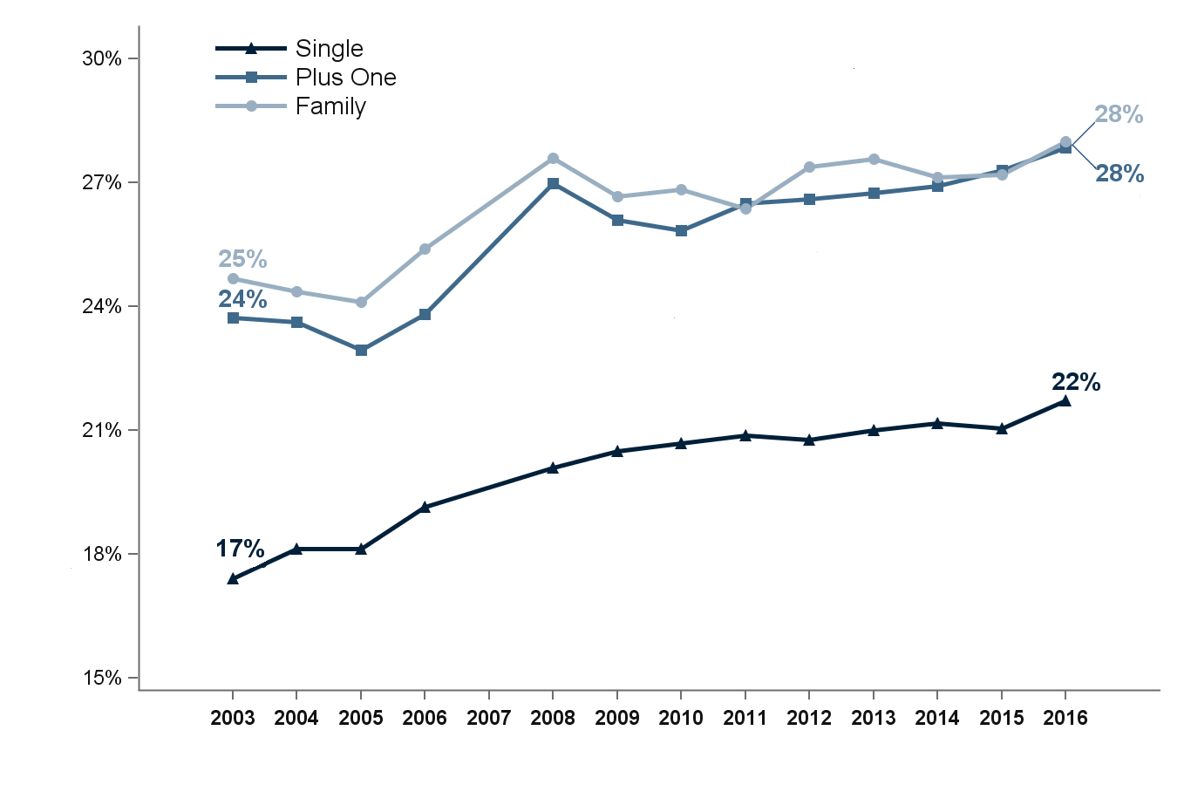
Average percentage of premium contributed by employees for single, employee-plus-one, and family coverage, 2003-2016
Source: Medical Expenditure Panel Survey-Insurance Component, private-sector establishments, 2003-2016.
Note: Medical Expenditure Panel Survey-Insurance Component estimates are not available for 2007.

Slide 29
Average percentage of premium contributed by employees for single, employee-plus-one, and family coverage, 2003-2016
Coverage | 2003 | 2004 | 2005 | 2006 | 2008 | 2009 | 2010 | 2011 | 2012 | 2013 | 2014 | 2015 | 2016
Single | 17.4% | 18.1% | 18.1% | 19.1% | 20.1% | 20.5% | 20.7% | 20.9% | 20.8% | 21.0% | 21.2% | 21.1% | 21.7%
 | (0.3%) | (0.2%) | (0.4%) | (0.4%) | (0.2%) | (0.3%) | (0.2%) | (0.2%) | (0.3%) | (0.3%) | (0.2%) | (0.2%) | (0.2%)
Plus One | 23.7% | 23.6% | 22.9% | 23.8% | 27.0% | 26.1% | 25.8% | 26.5% | 26.6% | 26.7% | 26.9% | 27.3% | 27.8%
 | (0.4%) | (0.5%) | (0.4%) | (0.4%) | (0.3%) | (0.3%) | (0.3%) | (0.3%) | (0.4%) | (0.2%) | (0.3%) | (0.3%) | (0.3%)
Family | 24.7% | 24.4% | 24.1% | 25.4% | 27.6% | 26.7% | 26.8% | 26.4% | 27.4% | 27.6% | 27.1% | 27.2% | 28.0%
 | (0.4%) | (0.4%) | (0.4%) | (0.3%) | (0.4%) | (0.3%) | (0.4%) | (0.3%) | (0.4%) | (0.3%) | (0.3%) | (0.3%) | (0.3%)
Source: Medical Expenditure Panel Survey-Insurance Component, private-sector establishments, 2003-2016.
Note: Medical Expenditure Panel Survey-Insurance Component estimates are not available for 2007.

Slide 30
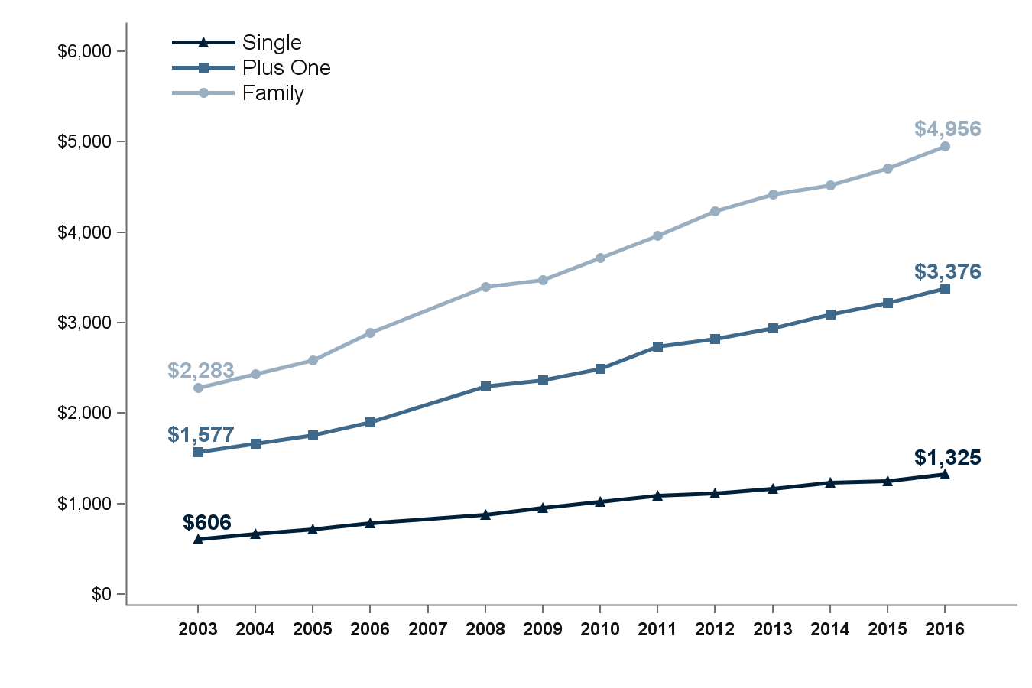
Average annual employee contribution (in dollars) for single, employee-plus-one, and family coverage, 2003-2016
Source: Medical Expenditure Panel Survey-Insurance Component, private-sector establishments, 2003-2016.
Note: Medical Expenditure Panel Survey-Insurance Component estimates are not available for 2007.

Slide 31
Average annual employee contribution (in dollars) for single, employee-plus-one, and family coverage, 2003-2016
Coverage | 2003 | 2004 | 2005 | 2006 | 2008 | 2009 | 2010 | 2011 | 2012 | 2013 | 2014 | 2015 | 2016
Single | $606 | $671 | $723 | $788 | $882 | $957 | $1,021 | $1,090 | $1,118 | $1,170 | $1,234 | $1,255 | $1,325
 | ($12) | ($8) | ($14) | ($16) | ($6) | ($13) | ($14) | ($9) | ($14) | ($16) | ($13) | ($14) | ($13)
Plus One | $1,577 | $1,667 | $1,759 | $1,903 | $2,303 | $2,363 | $2,498 | $2,736 | $2,824 | $2,940 | $3,097 | $3,220 | $3,376
 | ($28) | ($40) | ($29) | ($24) | ($22) | ($27) | ($42) | ($36) | ($46) | ($23) | ($40) | ($35) | ($36)
Family | $2,283 | $2,438 | $2,585 | $2,890 | $3,394 | $3,474 | $3,721 | $3,962 | $4,236 | $4,421 | $4,518 | $4,710 | $4,956
 | ($36) | ($39) | ($38) | ($34) | ($54) | ($44) | ($53) | ($42) | ($69) | ($50) | ($48) | ($56) | ($56)
Source: Medical Expenditure Panel Survey-Insurance Component, private-sector establishments, 2003-2016.
Note: Medical Expenditure Panel Survey-Insurance Component estimates are not available for 2007.

Slide 32
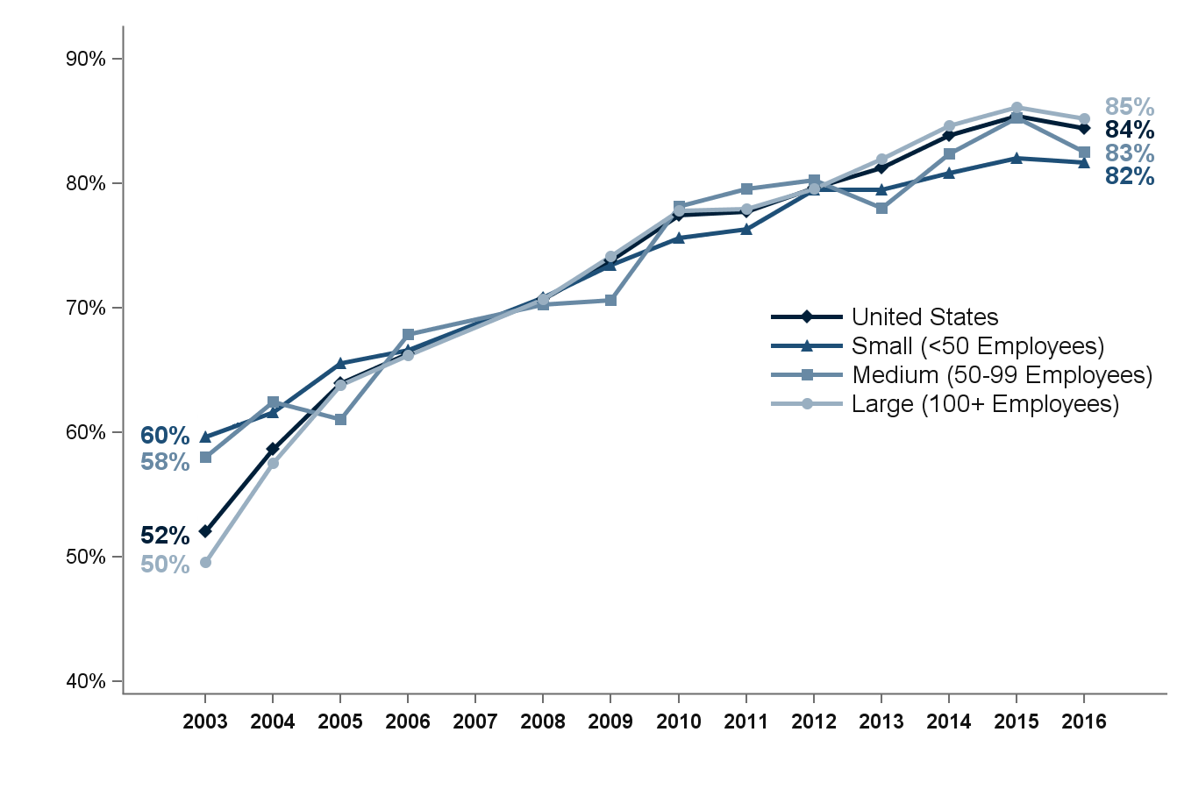
Percentage of private-sector enrolled employees in a health insurance plan with a deductible, overall and by firm size, 2003-2016
Source: Medical Expenditure Panel Survey-Insurance Component, private-sector establishments, 2003-2016.
Note: Medical Expenditure Panel Survey-Insurance Component estimates are not available for 2007.

Slide 33
Percentage of private-sector enrolled employees in a health insurance plan with a deductible, overall and by firm size, 2003-2016
Number of Employees | 2003 | 2004 | 2005 | 2006 | 2008 | 2009 | 2010 | 2011 | 2012 | 2013 | 2014 | 2015 | 2016
U.S. | 52.1% | 58.7% | 63.9% | 66.4% | 70.7% | 73.8% | 77.5% | 77.8% | 79.6% | 81.3% | 83.9% | 85.4% | 84.5%
 | (0.7%) | (0.8%) | (0.9%) | (0.6%) | (0.5%) | (0.5%) | (0.3%) | (0.7%) | (0.6%) | (0.7%) | (0.5%) | (0.5%) | (0.5%)
<50 | 59.7% | 61.6% | 65.5% | 66.6% | 70.9% | 73.5% | 75.7% | 76.3% | 79.5% | 79.5% | 80.8% | 82.1% | 81.7%
 | (1.1%) | (0.7%) | (1.0%) | (0.7%) | (0.7%) | (0.7%) | (0.7%) | (0.4%) | (1.0%) | (0.8%) | (0.8%) | (0.8%) | (0.8%)
50-99 | 58.0% | 62.5% | 61.1% | 67.9% | 70.3% | 70.6% | 78.2% | 79.6% | 80.3% | 78.0% | 82.4% | 85.3% | 82.5%
 | (1.8%) | (2.1%) | (2.6%) | (2.6%) | (1.4%) | (1.9%) | (1.5%) | (1.7%) | (1.4%) | (1.1%) | (1.5%) | (1.5%) | (1.5%)
100+ | 49.6% | 57.6% | 63.8% | 66.2% | 70.7% | 74.2% | 77.8% | 77.9% | 79.6% | 81.9% | 84.6% | 86.1% | 85.2%
 | (1.1%) | (1.0%) | (1.0%) | (0.8%) | (0.6%) | (0.6%) | (0.3%) | (1.0%) | (0.7%) | (0.7%) | (0.6%) | (0.6%) | (0.6%)
Source: Medical Expenditure Panel Survey-Insurance Component, private-sector establishments, 2003-2016.
Note: Medical Expenditure Panel Survey-Insurance Component estimates are not available for 2007.

Slide 34
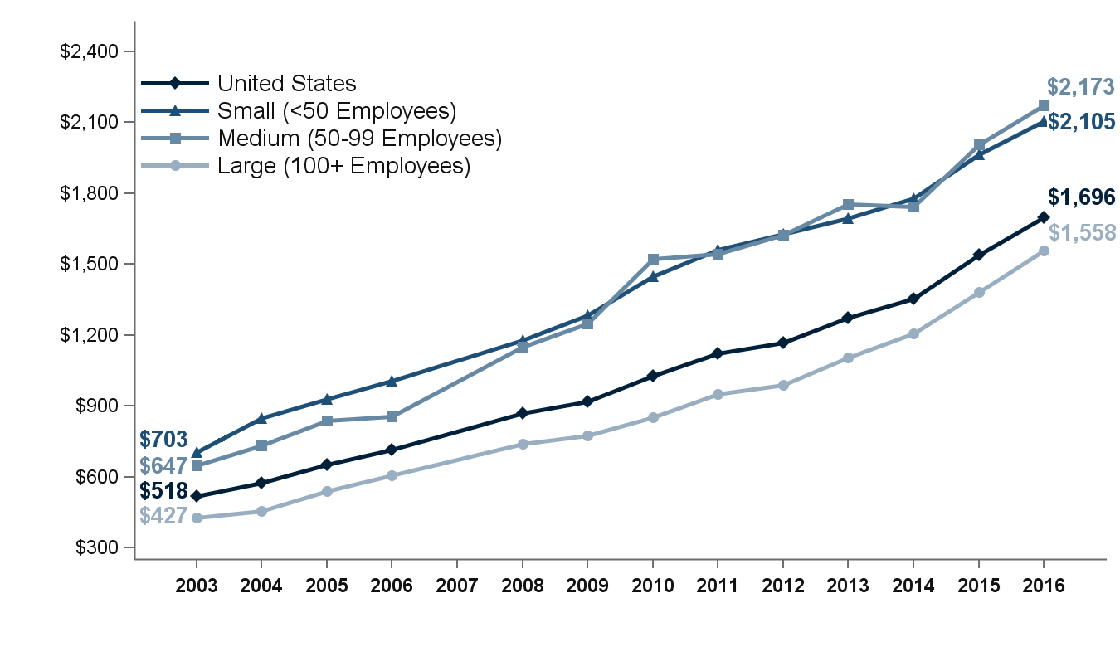
Average individual deductible (in dollars) per employee enrolled with single coverage in a health insurance plan with a deductible, overall and by firm size, 2003-2016
Source: Medical Expenditure Panel Survey-Insurance Component, private-sector establishments, 2003-2016.
Note: Medical Expenditure Panel Survey-Insurance Component estimates are not available for 2007. In 2015, the methodology for calibrating the upper edit bound for the individual deductible amount changed, causing the average individual deductible per employee enrolled with single coverage in a heath insurance plan with a deductible to increase by about 5 percent at the national level in 2015 relative to the earlier methodology.

Slide 35
Average individual deductible (in dollars) per employee enrolled with single coverage in a health insurance plan with a deductible, overall and by firm size, 2003-2016
Number of Employees | 2003 | 2004 | 2005 | 2006 | 2008 | 2009 | 2010 | 2011 | 2012 | 2013 | 2014 | 2015 | 2016
U.S. | $518 | $573 | $652 | $714 | $869 | $917 | $1,025 | $1,123 | $1,167 | $1,273 | $1,353 | $1,541 | $1,696
 | ($10) | ($10) | ($11) | ($9) | ($7) | ($9) | ($18) | ($12) | ($8) | ($20) | ($13) | ($16) | ($16)
<50 | $703 | $849 | $929 | $1,007 | $1,177 | $1,283 | $1,447 | $1,561 | $1,628 | $1,695 | $1,777 | $1,964 | $2,105
 | ($14) | ($21) | ($20) | ($20) | ($13) | ($24) | ($21) | ($26) | ($25) | ($24) | ($28) | ($35) | ($34)
50-99 | $647 | $733 | $836 | $855 | $1,149 | $1,249 | $1,522 | $1,543 | $1,622 | $1,755 | $1,744 | $2,008 | $2,173
 | ($20) | ($50) | ($67) | ($71) | ($62) | ($46) | ($57) | ($49) | ($64) | ($49) | ($59) | ($62) | ($64)
100+ | $427 | $457 | $539 | $605 | $740 | $774 | $852 | $951 | $989 | $1,106 | $1,205 | $1,383 | $1,558
 | ($10) | ($11) | ($9) | ($12) | ($8) | ($7) | ($20) | ($14) | ($10) | ($19) | ($14) | ($18) | ($18)
Source: Medical Expenditure Panel Survey-Insurance Component, private-sector establishments, 2003-2016.
Note: Medical Expenditure Panel Survey-Insurance Component estimates are not available for 2007. In 2015, the methodology for calibrating the upper edit bound for the individual deductible amount changed, causing the average individual deductible per employee enrolled with single coverage in a heath insurance plan with a deductible to increase by about 5 percent at the national level in 2015 relative to the earlier methodology.

