Slide 1
MEPS Insurance Component Presentation Slides
2019

Slide 2
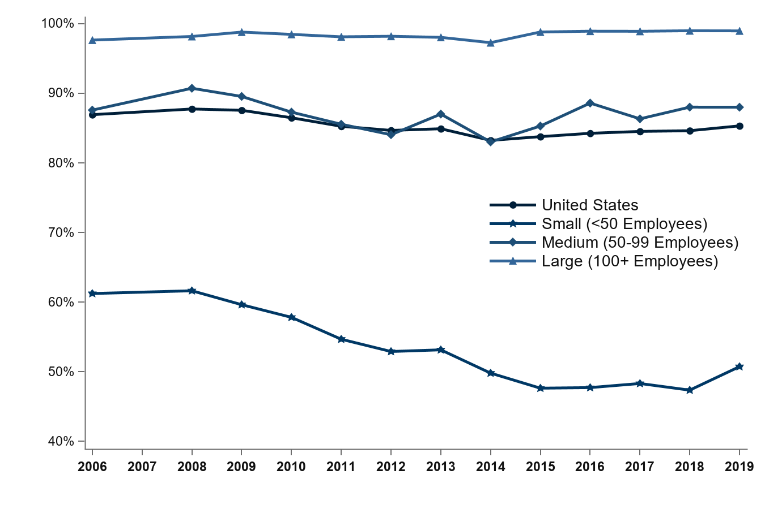
Percentage of private-sector employees in establishments that offer health insurance, by firm size, 2006-2019
97.7%
99.0%
87.6%
88.0%
86.9%
85.3%
61.2%
50.7%
Source: Medical Expenditure Panel Survey-Insurance Component, private-sector establishments, 2006-2019.
Note: Medical Expenditure Panel Survey-Insurance Component estimates are not available for 2007.

Slide 3
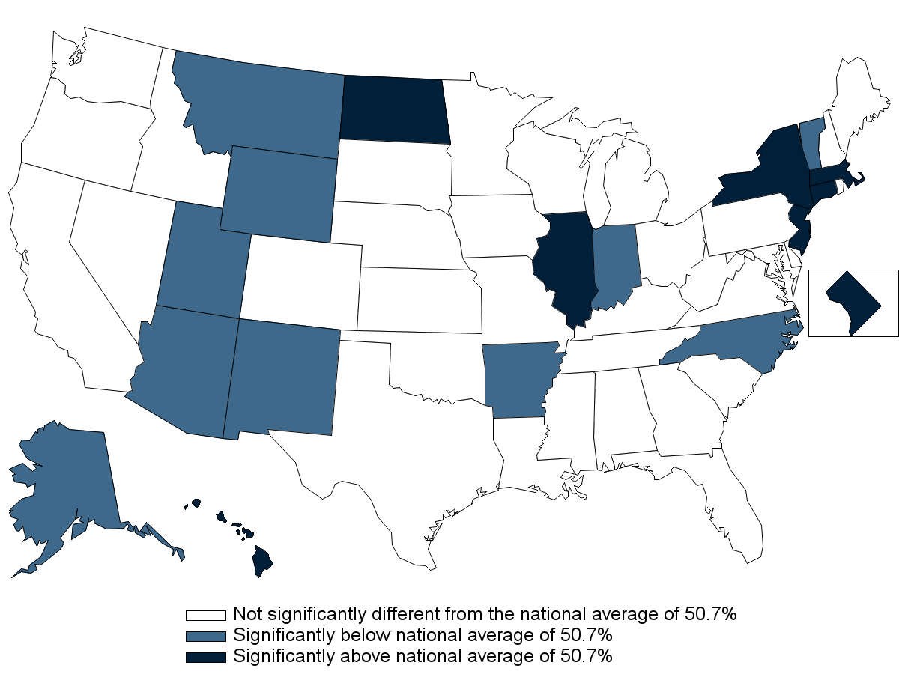
Percentage of private-sector employees in establishments that offer health insurance, by State, firm size <50 employees, 2019
Source: Medical Expenditure Panel Survey-Insurance Component, private-sector establishments, 2019.

Slide 4
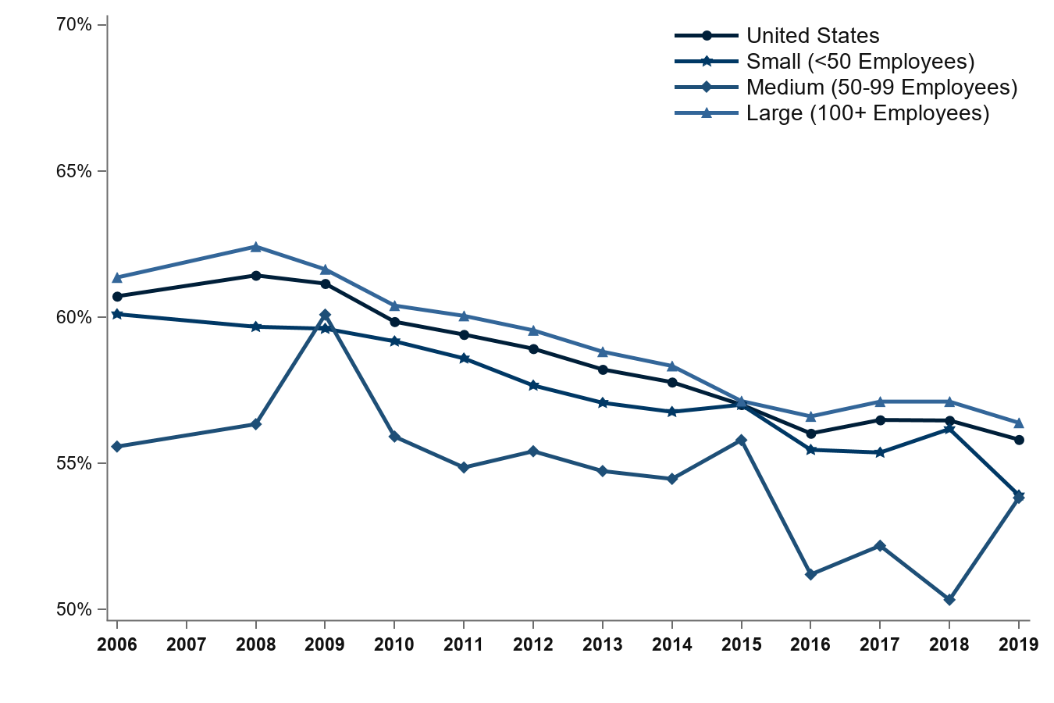
Percentage of private-sector employees who are enrolled in health insurance at establishments that offer health insurance, overall and by firm size, 2006-2019
61.4%
60.7%
60.1%
56.4%
55.6%
55.8%
53.9%
53.8%
Source: Medical Expenditure Panel Survey-Insurance Component, private-sector establishments, 2006-2019.
Denominator: Within each category, all employees in establishments that offer health insurance.
Note: Medical Expenditure Panel Survey-Insurance Component estimates are not available for 2007.

Slide 5
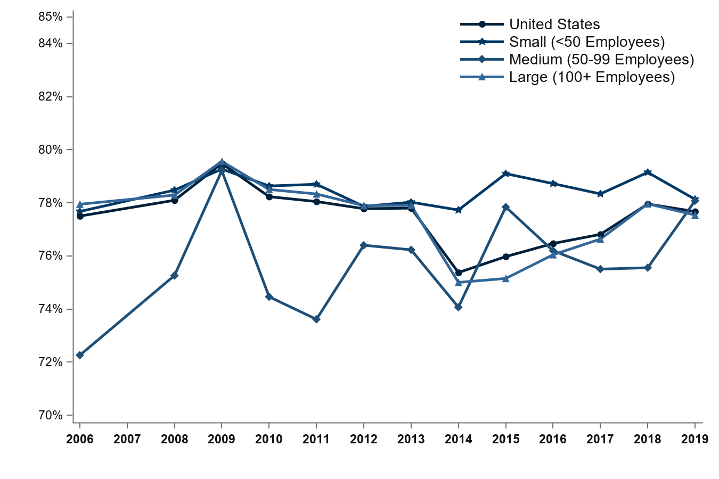
Percentage of private-sector employees eligible for health insurance at establishments that offer health insurance, overall and by firm size, 2006-2019
77.9%
78.1%
77.7%
78.1%
77.7%
77.5%
77.5%
72.3%
Source: Medical Expenditure Panel Survey-Insurance Component, private-sector establishments, 2006-2019.
Denominator: Within each category, all employees in establishments that offer health insurance.
Note: Medical Expenditure Panel Survey-Insurance Component estimates are not available for 2007.

Slide 6
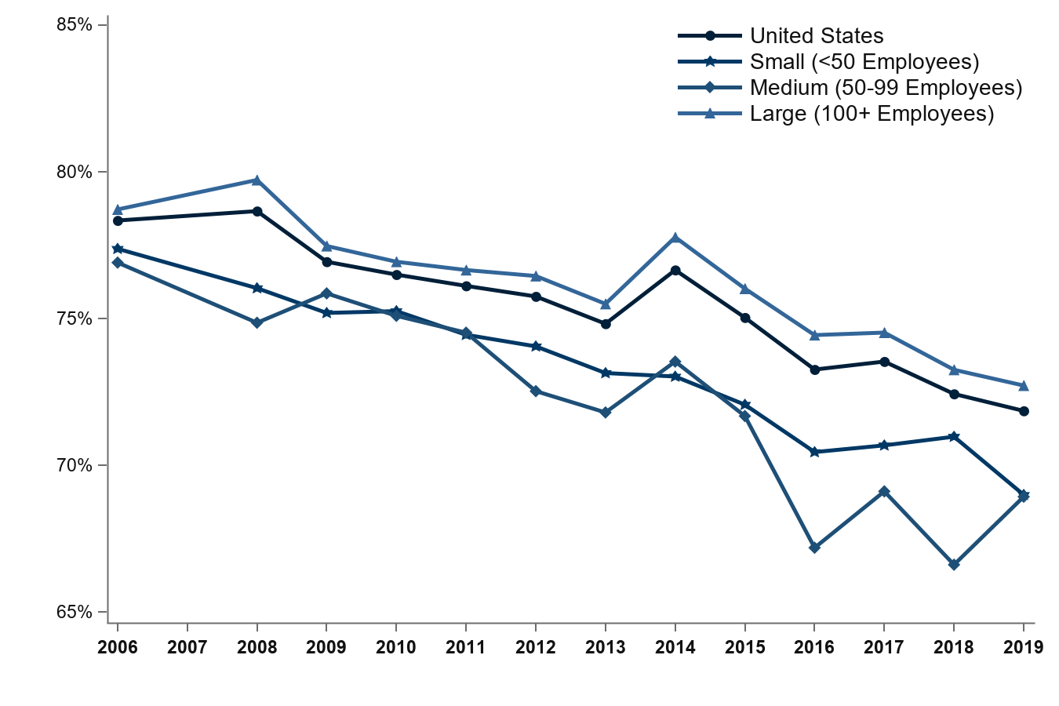
Percentage of eligible private-sector employees who are enrolled in health insurance at establishments that offer health insurance, overall and by firm size, 2006-2019
78.7%
78.3%
77.4%
76.9%
72.7%
71.9%
69.0%
68.9%
Source: Medical Expenditure Panel Survey-Insurance Component, private-sector establishments, 2006-2019.
Denominator: Within each category, eligible employees in establishments that offer health insurance.
Note: Medical Expenditure Panel Survey-Insurance Component estimates are not available for 2007.

Slide 7
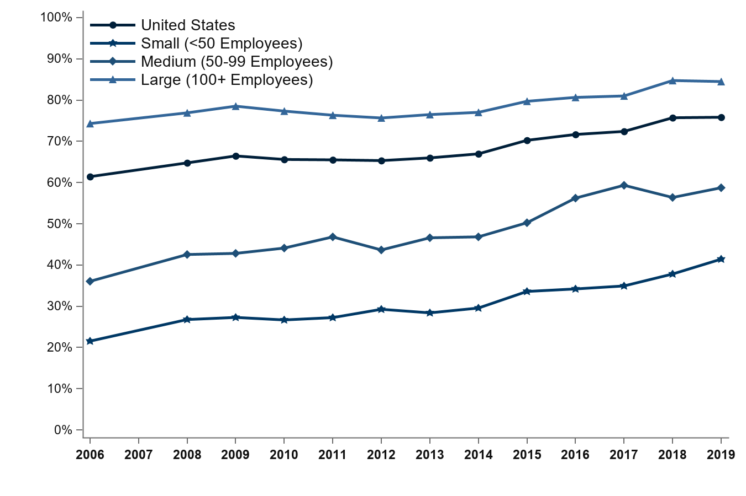
Percentage of private-sector employees working in establishments that offer two or more health insurance plans, overall and by firm size, 2006-2019
84.5%
74.3%
75.8%
61.4%
58.7%
41.4%
36.0%
21.5%
Source: Medical Expenditure Panel Survey-Insurance Component, private-sector establishments, 2006-2019.
Denominator: Within each category, all employees in establishments that offer health insurance.
Note: Medical Expenditure Panel Survey-Insurance Component estimates are not available for 2007.

Slide 8
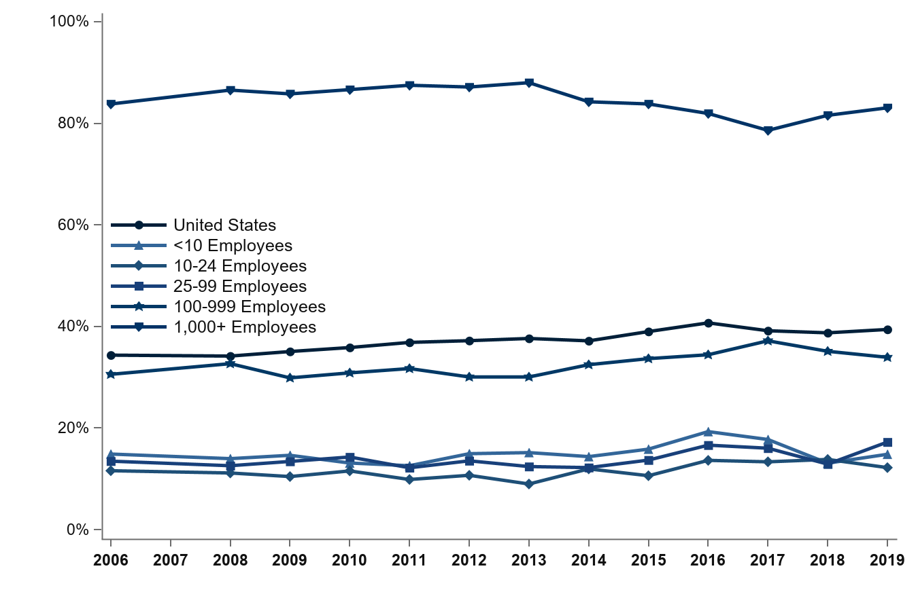
Percentage of private-sector establishments that offer health insurance that self-insure at least one plan, overall and by detailed firm size, 2006-2019
83.8%
83.1%
39.4%
34.4%
33.9%
30.6%
14.9%
17.2%
13.5%
14.8%
11.6%
12.2%
Source: Medical Expenditure Panel Survey-Insurance Component, private-sector establishments, 2006-2019.
Note: Medical Expenditure Panel Survey-Insurance Component estimates are not available for 2007.

Slide 9
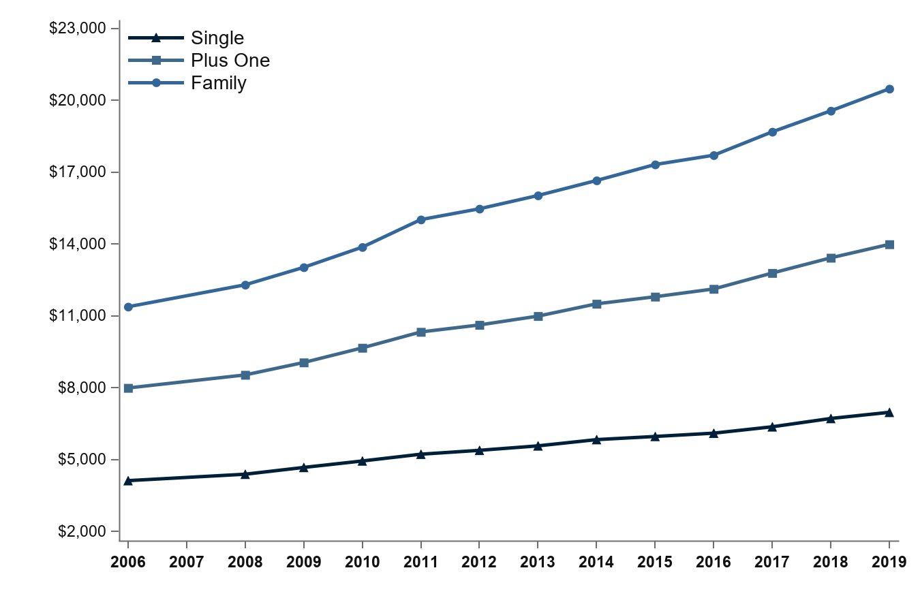
Average total premiums per enrolled employee for single, employee-plus-one, and family coverage, 2006-2019
$20,486
$13,989
$11,381
$7,988
$6,972
$4,118
Source: Medical Expenditure Panel Survey-Insurance Component, private-sector establishments, 2006-2019.
Note: Medical Expenditure Panel Survey-Insurance Component estimates are not available for 2007.

Slide 10
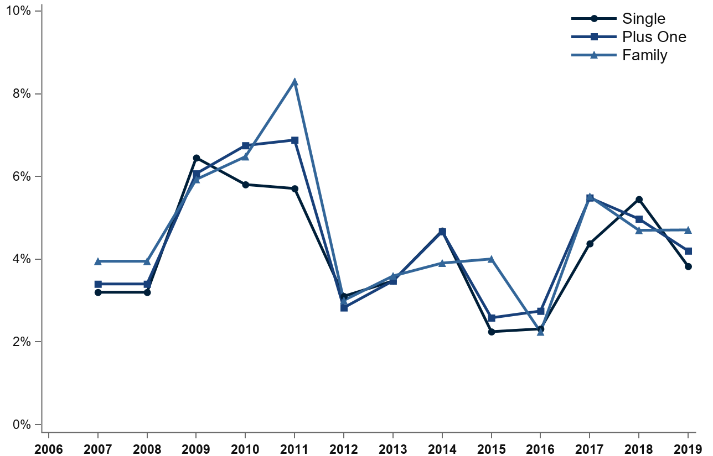
Percentage change in total premiums from previous year per enrolled employee for single, employee-plus-one, and family coverage, 2006-2019
4.7%
4.0%
4.2%
3.8%
3.4%
3.2%
Source: Medical Expenditure Panel Survey-Insurance Component, private-sector establishments, 2006-2019.
Note: Medical Expenditure Panel Survey-Insurance Component estimates are not available for 2007. Therefore, growth rates were annualized over the 2006-2008 period.

Slide 11
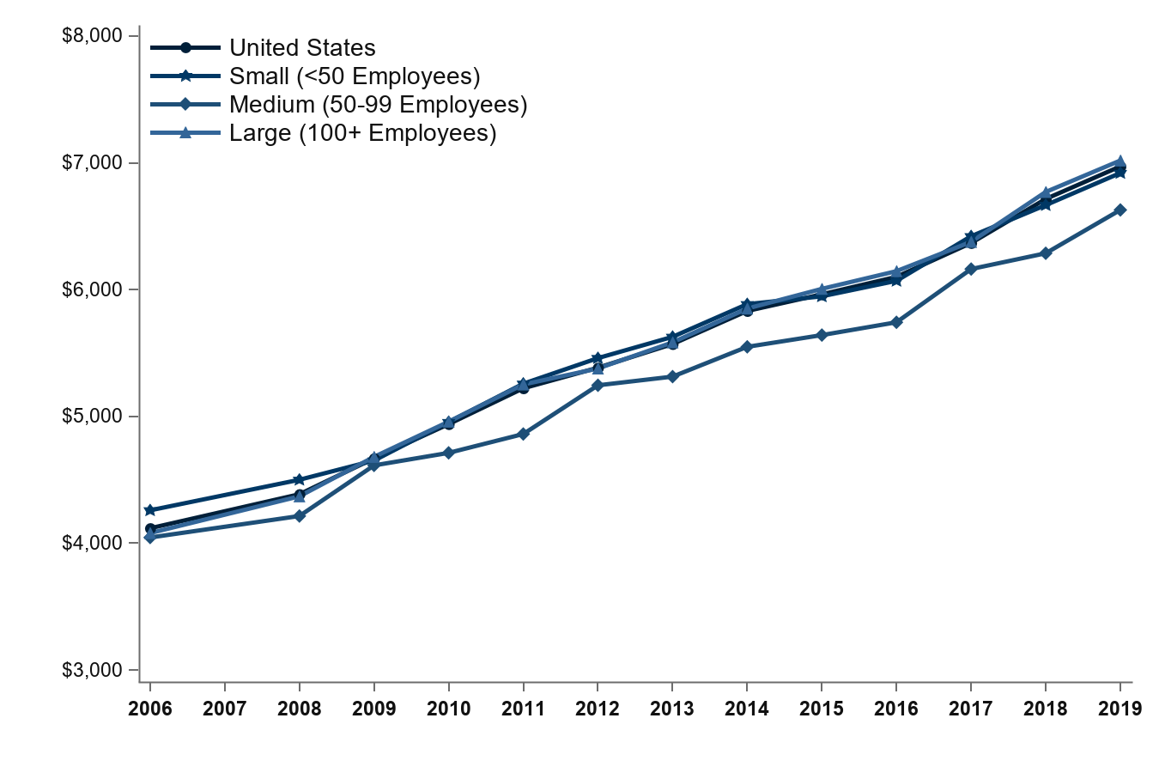
Average total single premium per enrolled employee, by firm size, 2006-2019
$7,019
$6,920
$6,972
$6,629
$4,260
$4,118
$4,080
$4,045
Source: Medical Expenditure Panel Survey-Insurance Component, private-sector establishments, 2006-2019.
Note: Medical Expenditure Panel Survey-Insurance Component estimates are not available for 2007.

Slide 12
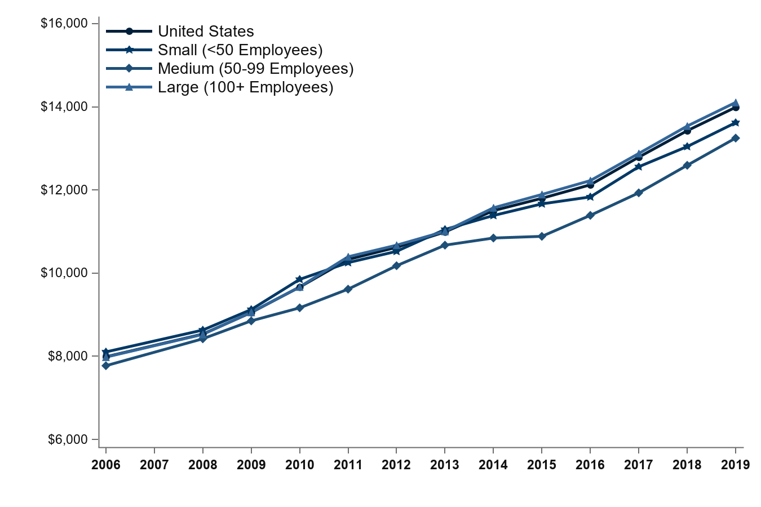
Average total employee-plus-one premium per enrolled employee, by firm size, 2006-2019
$14,105
$13,989
$13,619
$13,248
$8,105
$7,988
$7,981
$7,774
Source: Medical Expenditure Panel Survey-Insurance Component, private-sector establishments, 2006-2019.
Note: Medical Expenditure Panel Survey-Insurance Component estimates are not available for 2007.

Slide 13
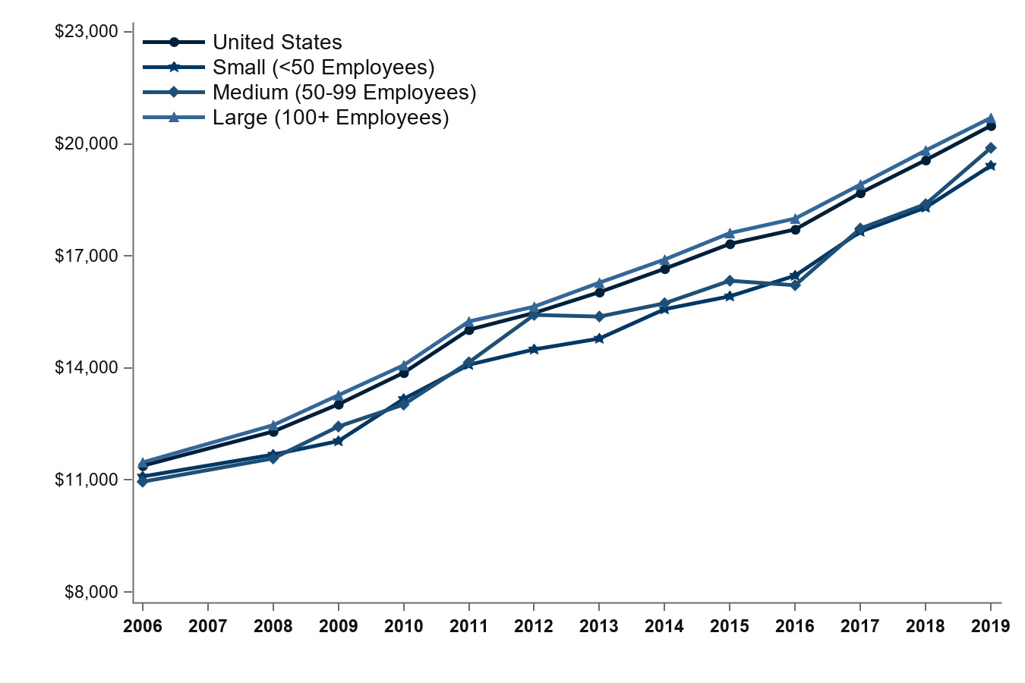
Average total family premium per enrolled employee, by firm size, 2006-2019
$20,697
$20,486
$19,893
$19,417
$11,471
$11,381
$11,095
$10,954
Source: Medical Expenditure Panel Survey-Insurance Component, private-sector establishments, 2006-2019.
Note: Medical Expenditure Panel Survey-Insurance Component estimates are not available for 2007.

Slide 14
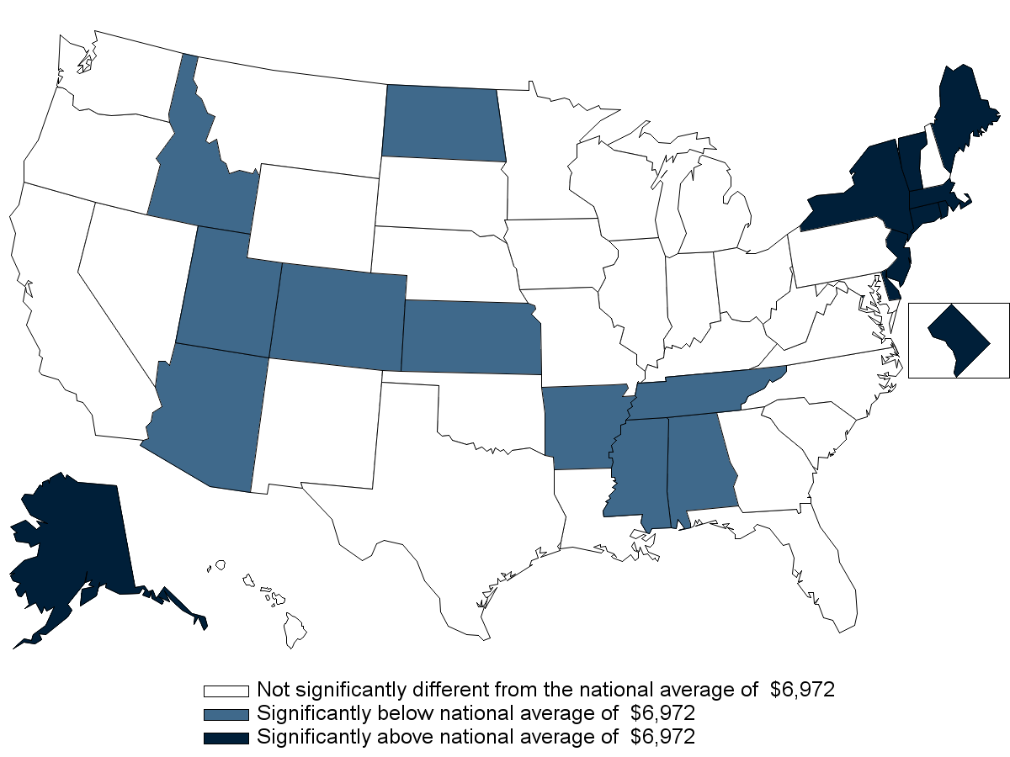
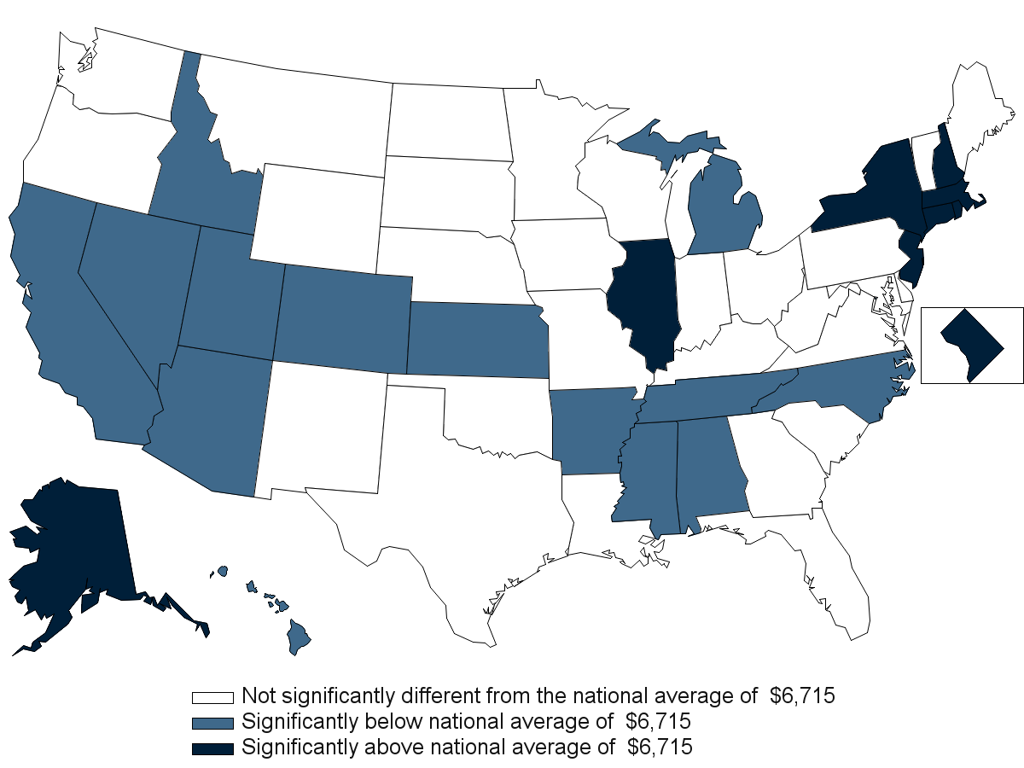
Average total single premium per enrolled employee, by State, 2019
Source: Medical Expenditure Panel Survey-Insurance Component, private-sector establishments, 2019.

Slide 15
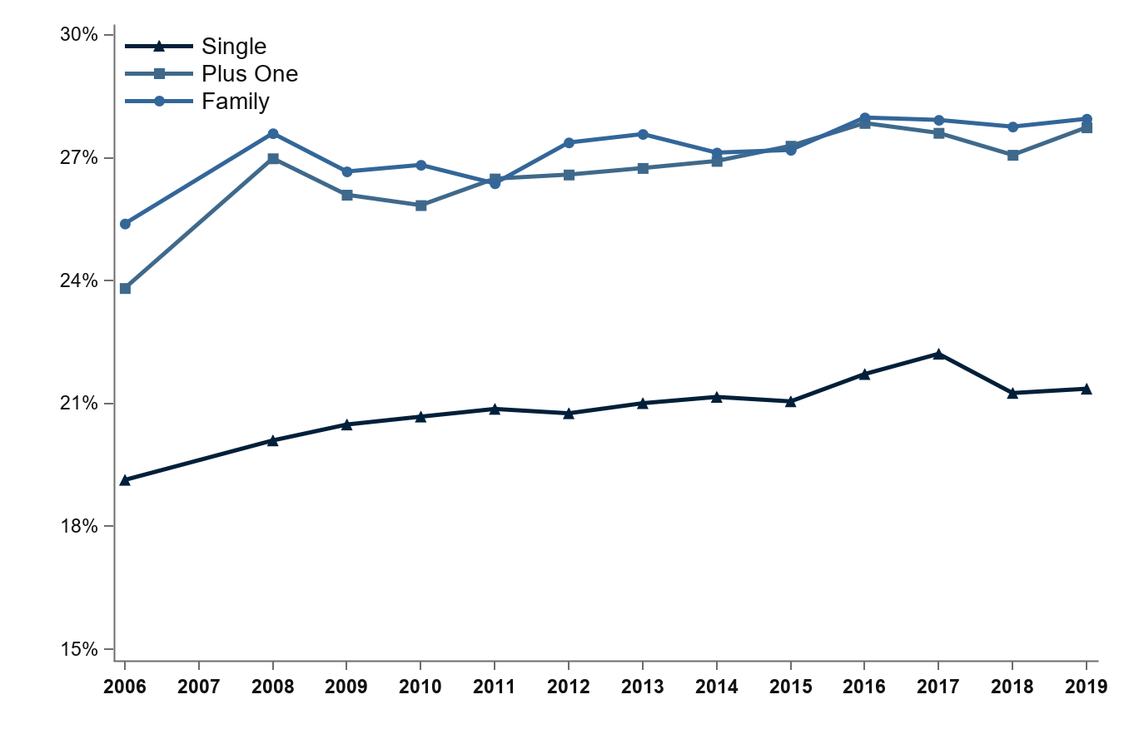
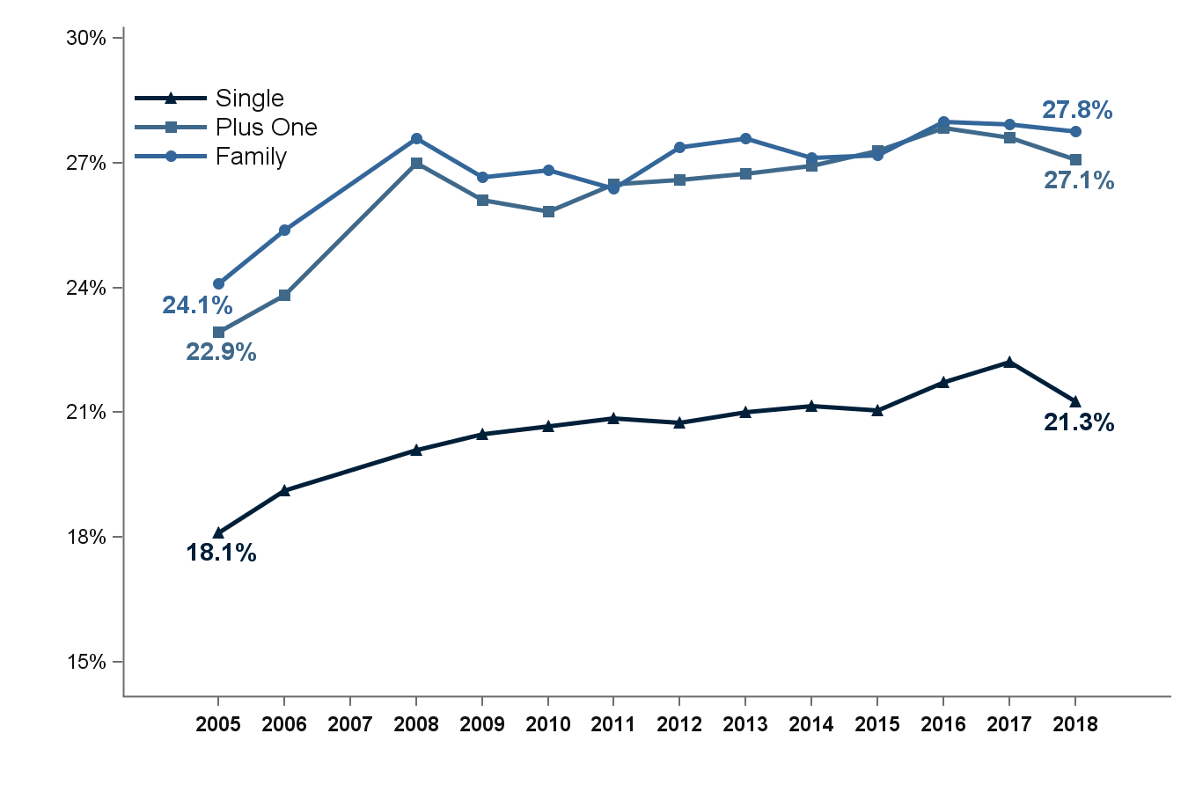
Average percentage of premium contributed by employees for single, employee-plus-one, and family coverage, 2006-2019
28.0%
27.7%
25.4%
23.8%
21.4%
19.1%
Source: Medical Expenditure Panel Survey-Insurance Component, private-sector establishments, 2006-2019.
Note: Medical Expenditure Panel Survey-Insurance Component estimates are not available for 2007.

Slide 16
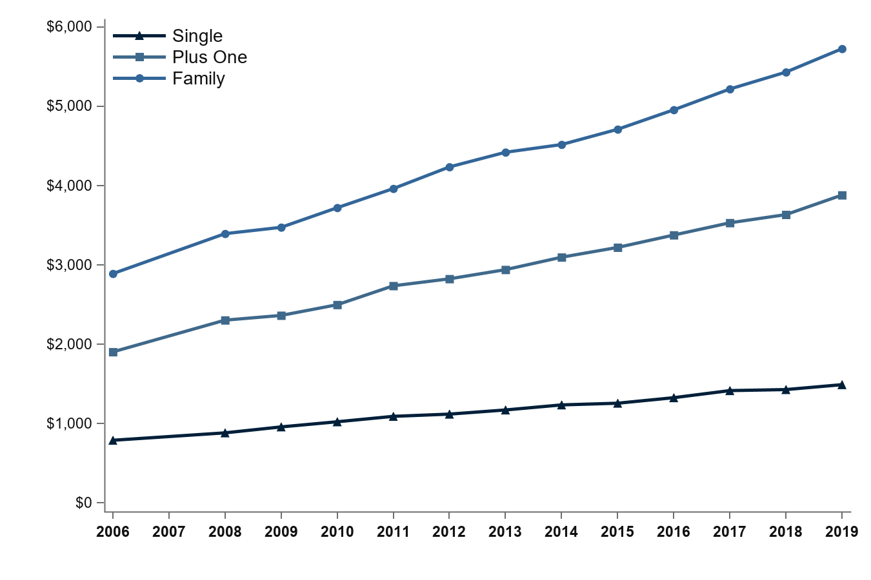
Average annual employee contribution (in dollars) for single, employee-plus-one, and family coverage, 2006-2019
$5,726
$3,881
$2,890
$1,903
$1,489
$788
Source: Medical Expenditure Panel Survey-Insurance Component, private-sector establishments, 2006-2019.
Note: Medical Expenditure Panel Survey-Insurance Component estimates are not available for 2007.

Slide 17
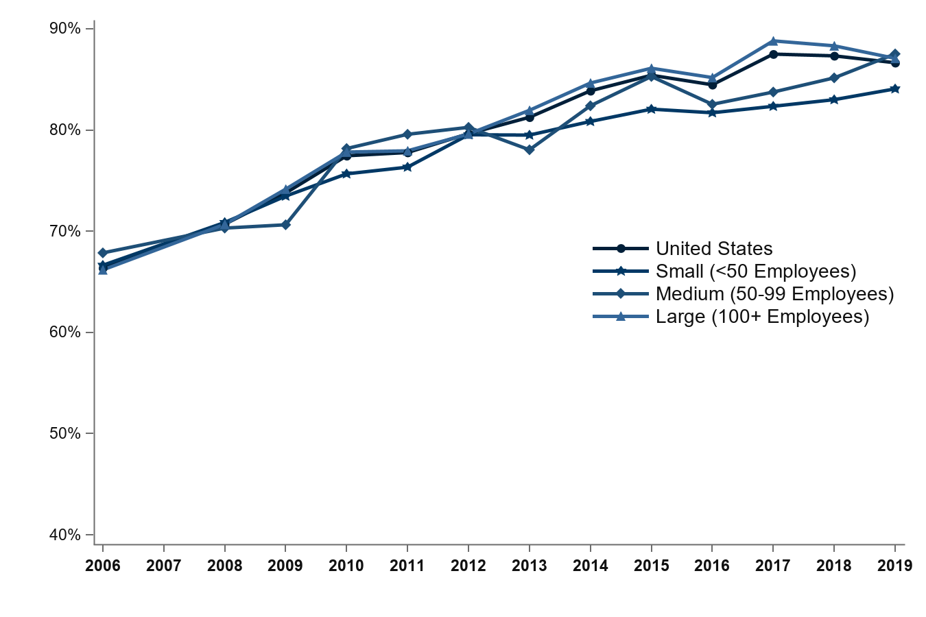
Percentage of private-sector enrolled employees in a health insurance plan with a deductible, overall and by firm size, 2006-2019
87.5%
87.1%
86.6%
84.1%
67.9%
66.6%
66.4%
66.2%
Source: Medical Expenditure Panel Survey-Insurance Component, private-sector establishments, 2006-2019.
Note: Medical Expenditure Panel Survey-Insurance Component estimates are not available for 2007.

Slide 18
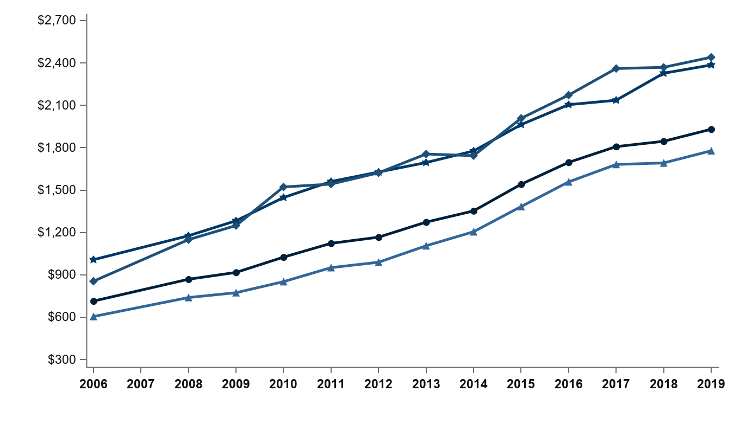
Average individual deductible (in dollars) per employee enrolled with single coverage in a health insurance plan with a deductible, overall and by firm size, 2006-2019
$2,441
$2,386
$1,931
$1,778
$1,007
$855
$714
$605
Source: Medical Expenditure Panel Survey-Insurance Component, private-sector establishments, 2006-2019.
Note: Medical Expenditure Panel Survey-Insurance Component estimates are not available for 2007. In 2015, the methodology for calibrating the upper edit bound for the individual deductible amount changed, causing the average individual deductible per
employee enrolled with single coverage in a health insurance plan with a deductible to increase by about 5
percent at the national level in 2015 relative to the earlier methodology.

