Slide 1
MEPS Insurance Component Presentation Slides
2021

Slide 2
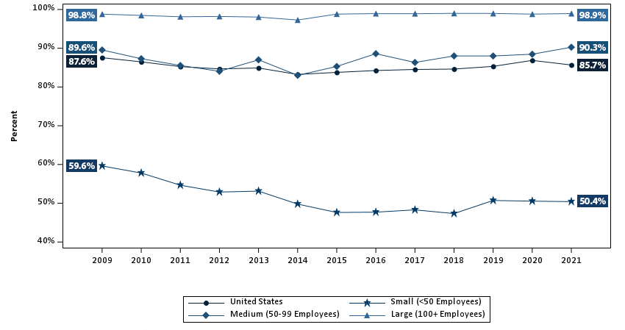
Percentage of private-sector employees in establishments that offer health insurance, by firm size, 2009-2021
Source: Medical Expenditure Panel Survey-Insurance Component, private-sector establishments, 2009-2021.

Slide 3
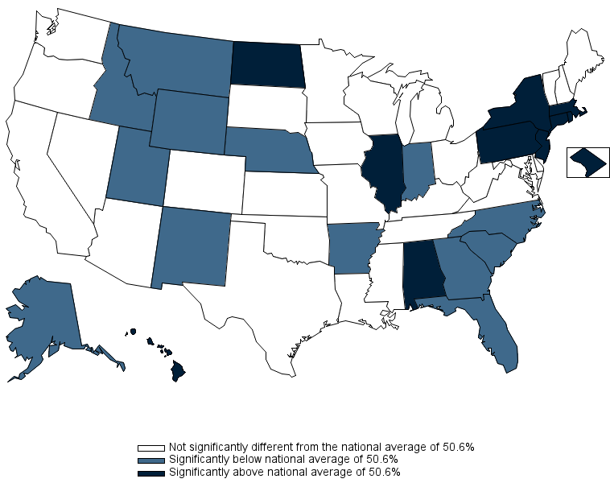
Percentage of private-sector employees in establishments that offer health insurance, by State, firm size <50 employees, 3-year average, 2019-2021
Source: Medical Expenditure Panel Survey-Insurance Component, private-sector establishments, 2019-2021.

Slide 4
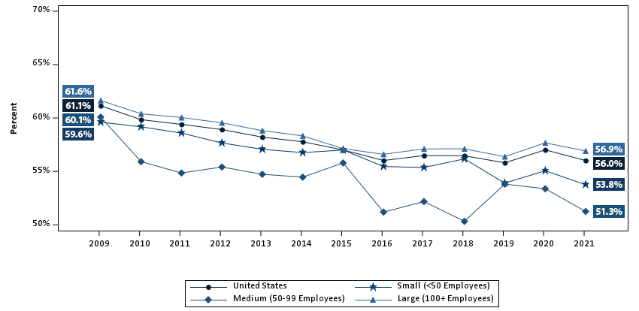
Percentage of private-sector employees who are enrolled in health insurance at establishments that offer health insurance, overall and by firm size, 2009-2021
Source: Medical Expenditure Panel Survey-Insurance Component, private-sector establishments, 2009-2021.
Denominator: Within each category, all employees in establishments that offer health insurance.

Slide 5
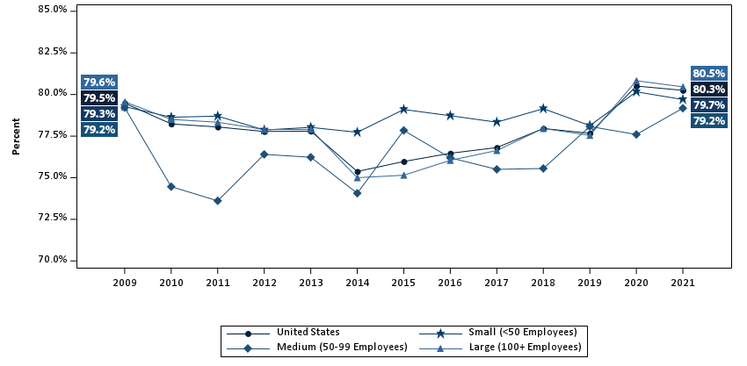
Percentage of private-sector employees eligible for health insurance at establishments that offer health insurance, overall and by firm size, 2009-2021
Source: Medical Expenditure Panel Survey-Insurance Component, private-sector establishments, 2009-2021.
Denominator: Within each category, all employees in establishments that offer health insurance.

Slide 6
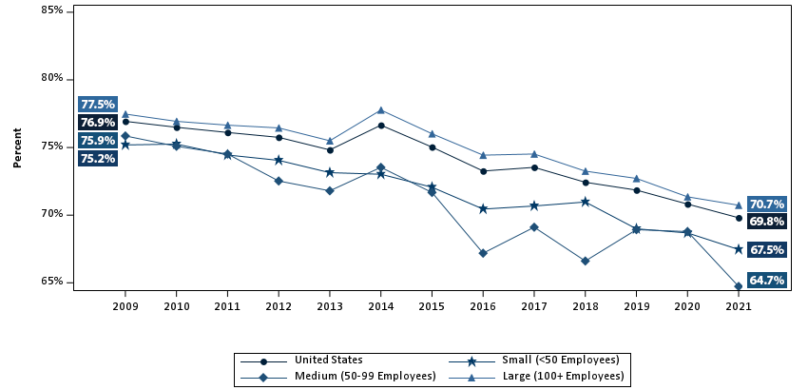
Percentage of eligible private-sector employees who are enrolled in health insurance at establishments that offer health insurance, overall and by firm size, 2009-2021
Source: Medical Expenditure Panel Survey-Insurance Component, private-sector establishments, 2009-2021.
Denominator: Within each category, eligible employees in establishments that offer health insurance.

Slide 7
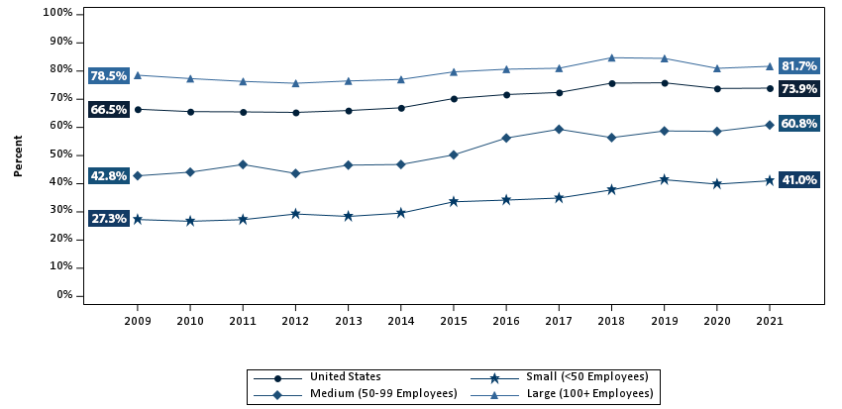
Percentage of private-sector employees working in establishments that offer two or more health insurance plans, overall and by firm size, 2009-2021
Source: Medical Expenditure Panel Survey-Insurance Component, private-sector establishments, 2009-2021.
Denominator: Within each category, all employees in establishments that offer health insurance.

Slide 8
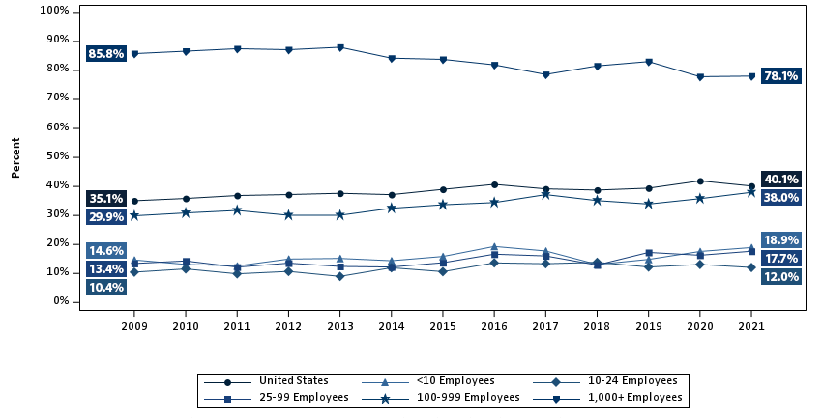
Percentage of private-sector establishments that offer health insurance that self-insure at least one plan, overall and by detailed firm size, 2009-2021
Source: Medical Expenditure Panel Survey-Insurance Component, private-sector establishments, 2009-2021.

Slide 9
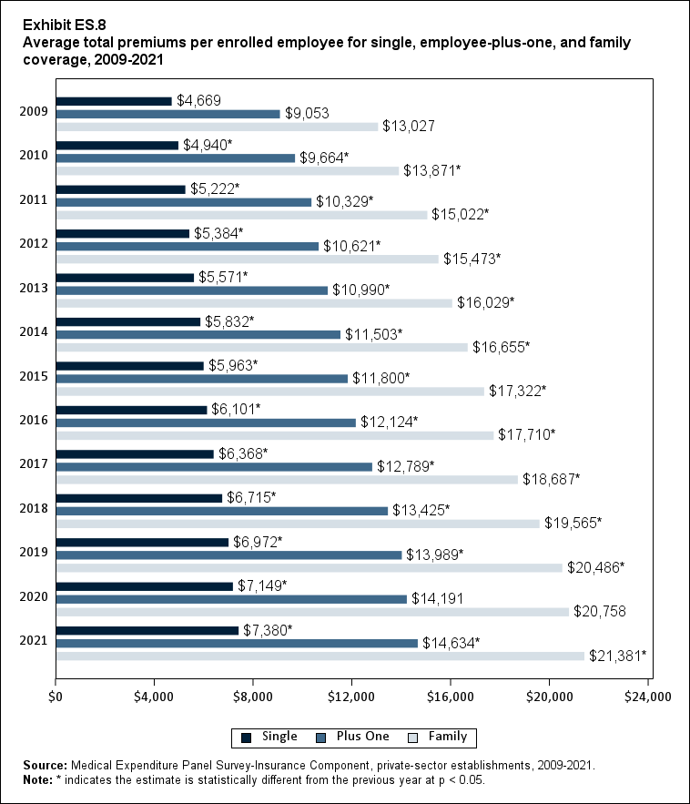
Average total premiums per enrolled employee for single, employee-plus-one, and family coverage, 2009-2021
Source: Medical Expenditure Panel Survey-Insurance Component, private-sector establishments, 2009-2021.
Note: * indicates the estimate is statistically different from the previous year at p < 0.05.

Slide 10
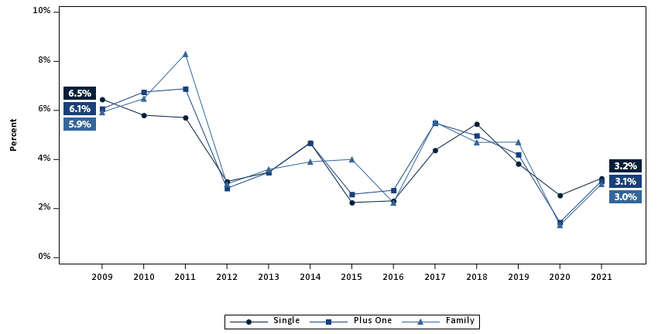
Percentage change in total premiums from previous year per enrolled employee for single, employee-plus-one, and family coverage, 2009-2021
Source: Medical Expenditure Panel Survey-Insurance Component, private-sector establishments, 2009-2021.

Slide 11
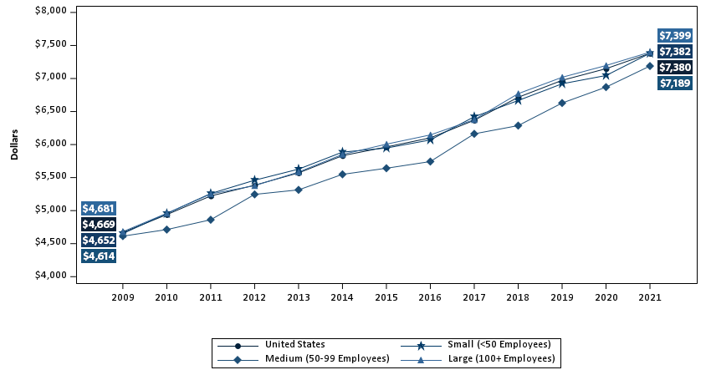
Average total single premium per enrolled employee, by firm size, 2009-2021
Source: Medical Expenditure Panel Survey-Insurance Component, private-sector establishments, 2009-2021.

Slide 12
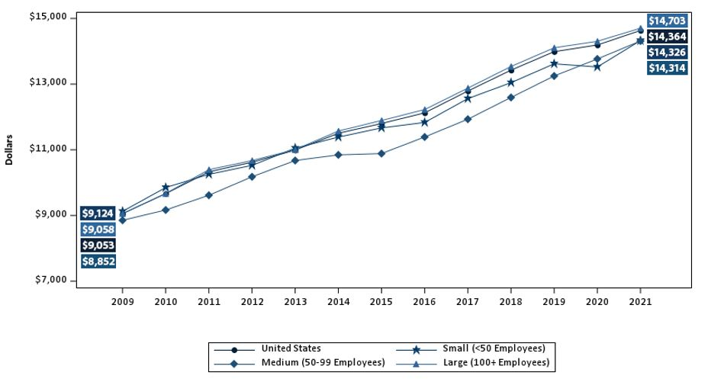
Average total employee-plus-one premium per enrolled employee, by firm size, 2009-2021
Source: Medical Expenditure Panel Survey-Insurance Component, private-sector establishments, 2009-2021.

Slide 13
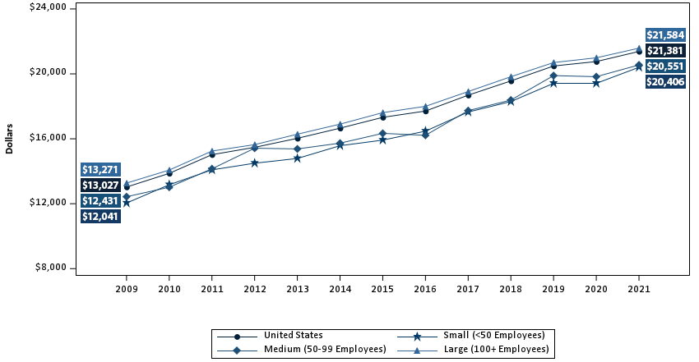
Average total family premium per enrolled employee, by firm size, 2009-2021
Source: Medical Expenditure Panel Survey-Insurance Component, private-sector establishments, 2009-2021.

Slide 14
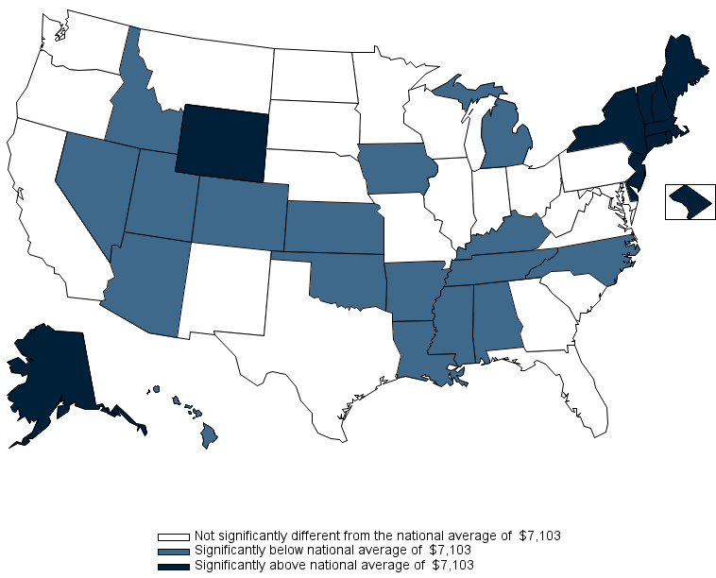
Average total single premium per enrolled employee, by State, 3-year average, 2019-2021
Source: Medical Expenditure Panel Survey-Insurance Component, private-sector establishments, 2019-2021.

Slide 15
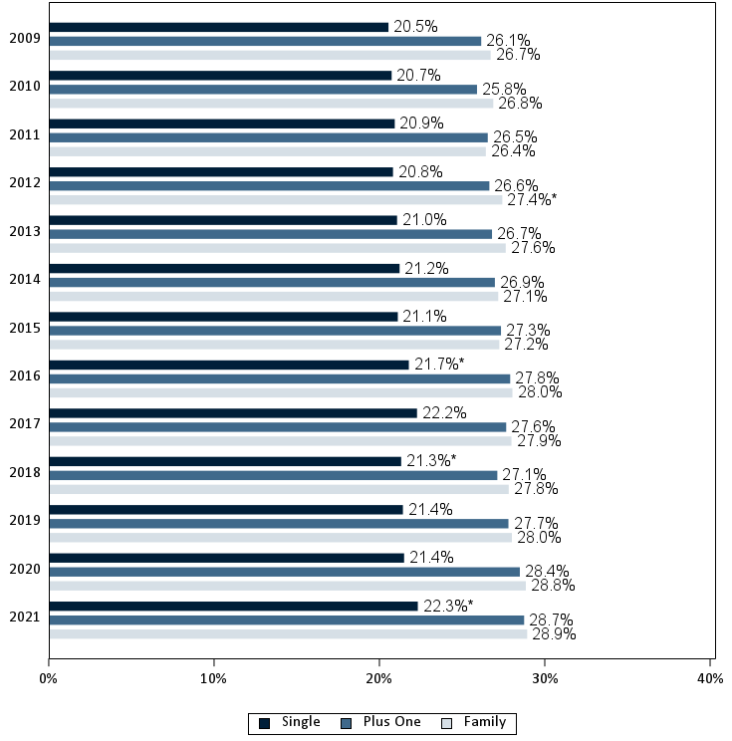
Average percentage of premium contributed by employees for single, employee-plus-one, and family coverage, 2009-2021
Source: Medical Expenditure Panel Survey-Insurance Component, private-sector establishments, 2009-2021. Note: * indicates the estimate is statistically different from the previous year at p < 0.05.

Slide 16
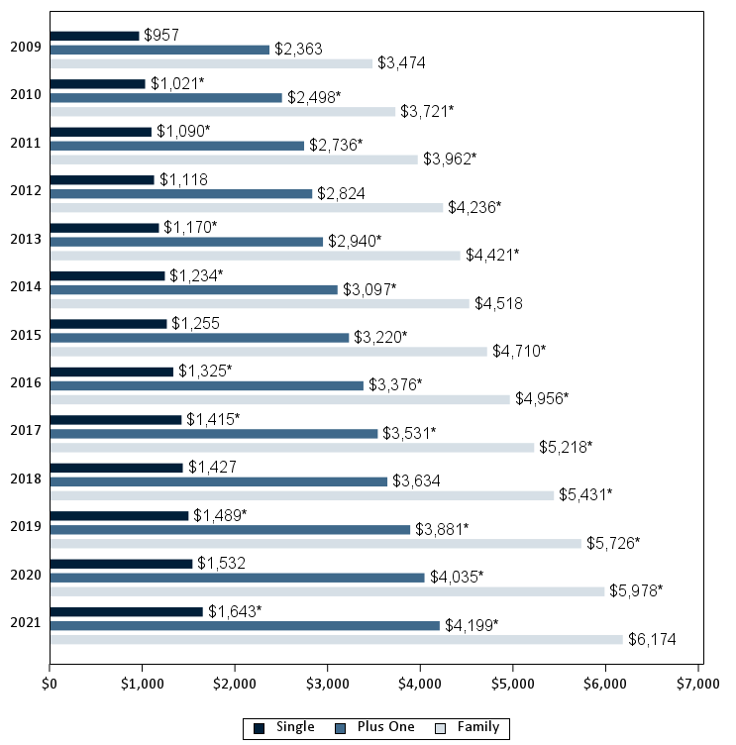
Average annual employee contribution (in dollars) for single, employee-plus-one, and family coverage, 2009-2021
Source: Medical Expenditure Panel Survey-Insurance Component, private-sector establishments, 2009-2021. Note: * indicates the estimate is statistically different from the previous year at p < 0.05.

Slide 17
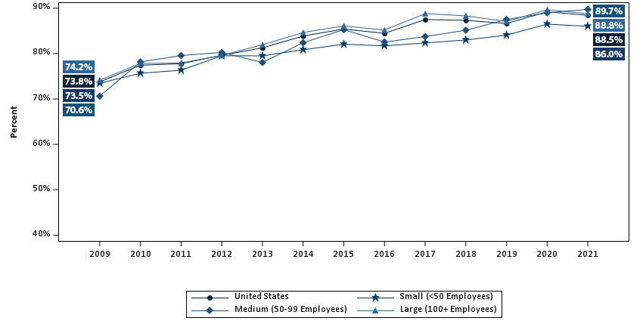
Percentage of private-sector enrolled employees in a health insurance plan with a deductible, overall and by firm size, 2009-2021
Source: Medical Expenditure Panel Survey-Insurance Component, private-sector establishments, 2009-2021.

Slide 18
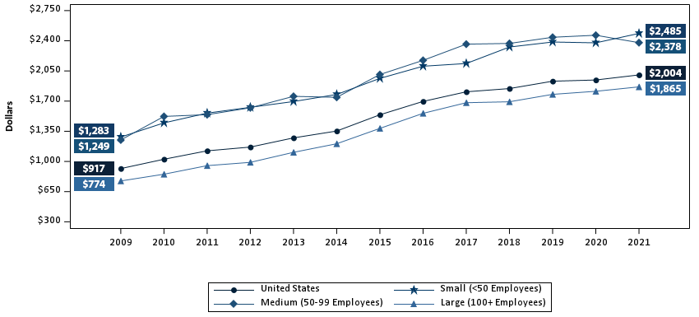
Average individual deductible (in dollars) per employee enrolled with single coverage in a health insurance plan with a deductible, overall and by firm size, 2009-2021
Source: Medical Expenditure Panel Survey-Insurance Component, private-sector establishments, 2009-2021.
Note: In 2015, the methodology for calibrating the upper edit bound for the individual deductible amount changed, causing the
average individual deductible per employee enrolled with single coverage in a health insurance plan with a deductible to increase by about 5 percent at the national level in 2015 relative to the earlier methodology.

